Slide 1
mouse_to_rat igv images

Slide 2
lifton better

Slide 3
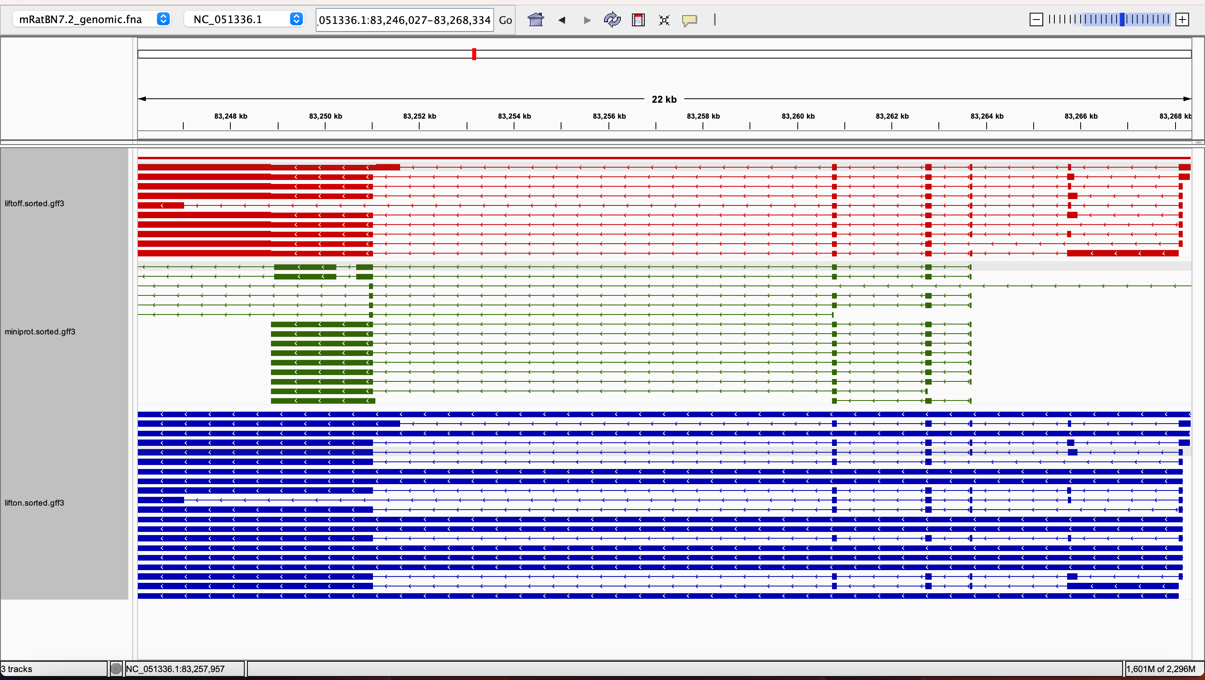
rna-XM_030242709.2 0.0059101654846335 0.9144021739130436 0.2214182852727336 0.9157608695652174 LiftOn_chaining_algorithm frameshift;stop_codon_gain NC_051336.1:83246027-83268334

Slide 4
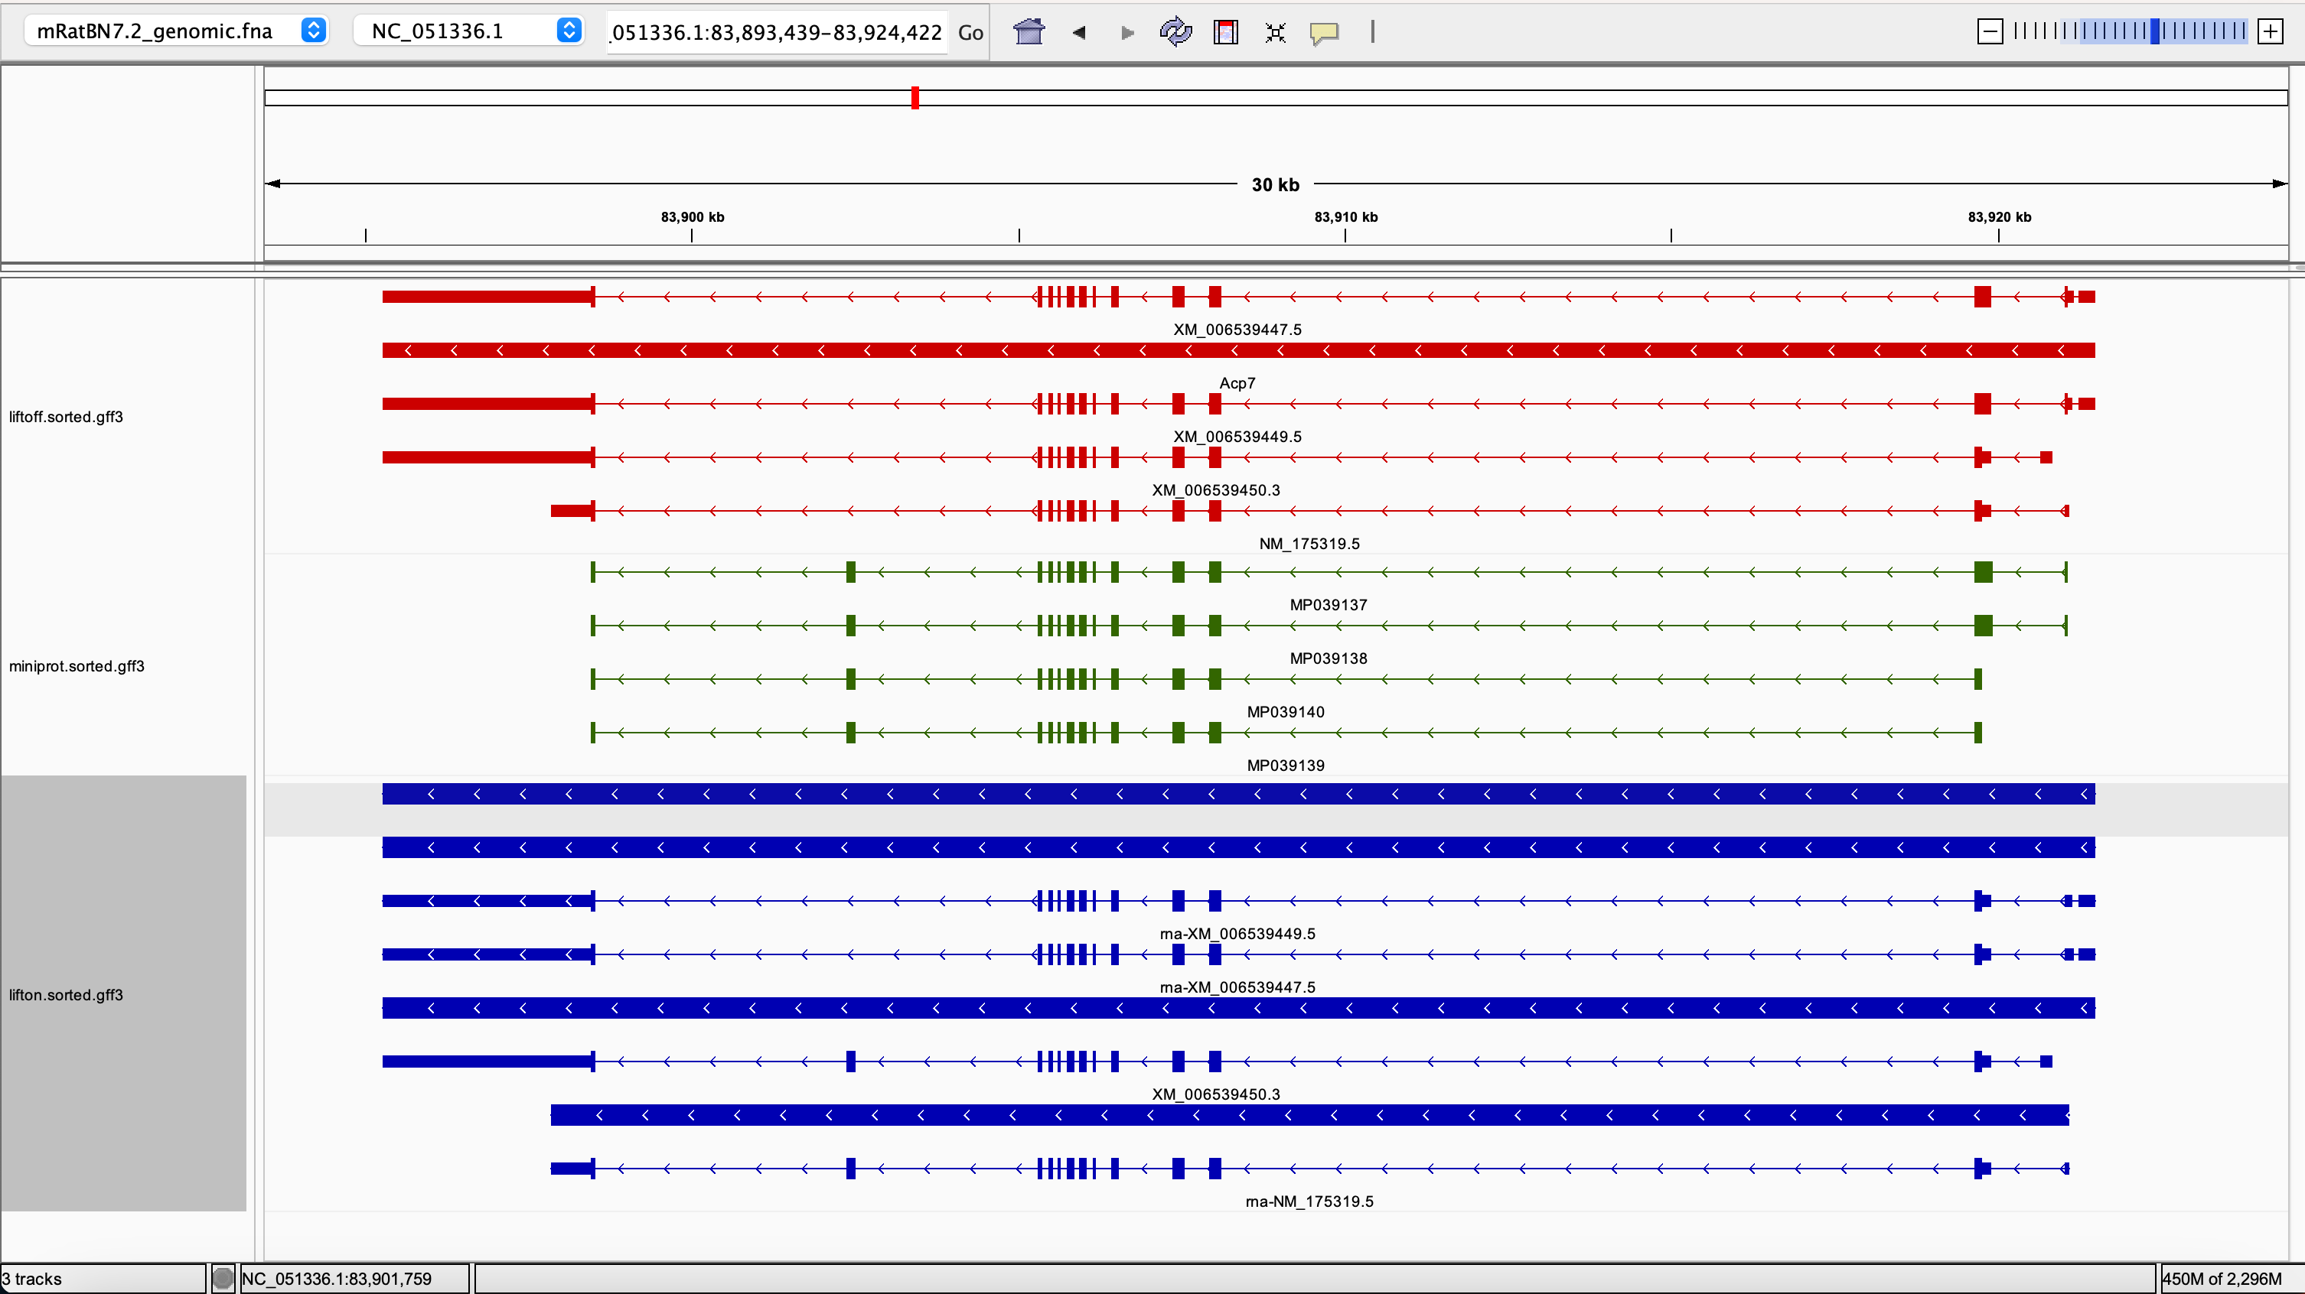
rna-XM_006539447.5 0.0769230769230769 0.073555166374781 0.8145054110499336 0.7505030181086519 LiftOn_chaining_algorithm frameshift;stop_codon_gain NC_051336.1:83895271-83921501

Slide 5
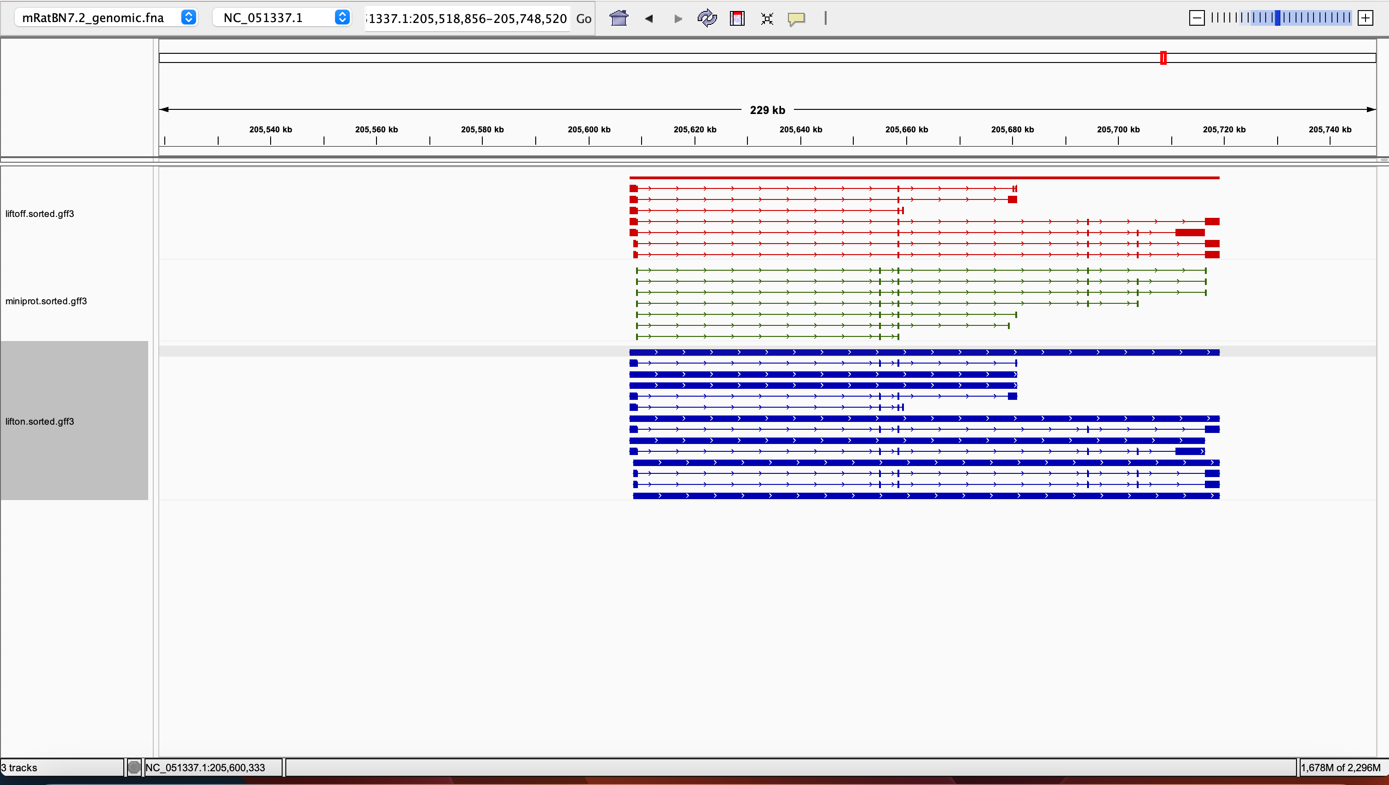
rna-XM_036163382.1 0.3755656108597285 0.9447004608294932 0.9105289174493326 0.9723502304147466 LiftOn_chaining_algorithm frameshift;stop_missing NC_051337.1:205607864-205659511

Slide 6
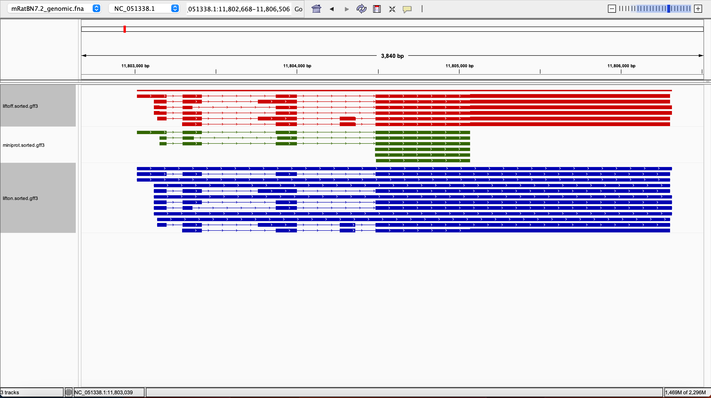
rna-XM_006497625.3 0.0354223433242506 0.0354223433242506 0.802510460251046 0.8254437869822485 LiftOn_chaining_algorithm frameshift;start_lost;stop_codon_gain NC_051338.1:11803013-11806304

Slide 7
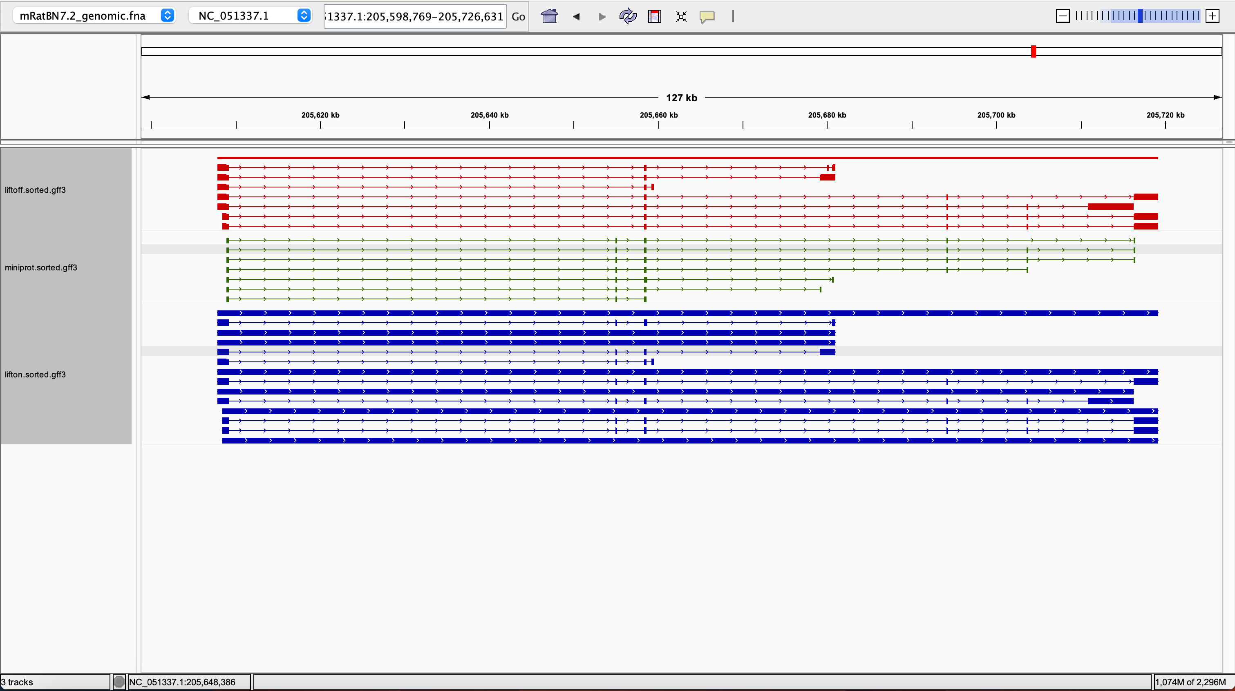
rna-XM_036163382.1 0.3755656108597285 0.9447004608294932 0.9105289174493326 0.9723502304147466 LiftOn_chaining_algorithm frameshift;stop_missing NC_051337.1:205607864-205659511

Slide 8
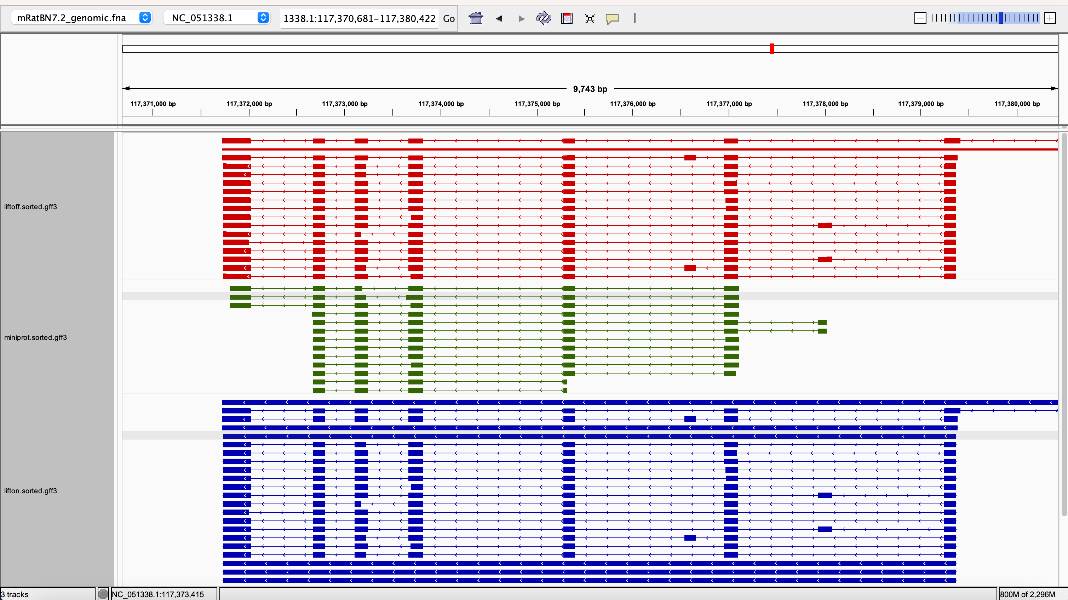
rna-NM_001412654.1 0.1115107913669064 0.9692307692307692 0.9353312302839116 0.9730769230769232 LiftOn_chaining_algorithm frameshift;stop_missing NC_051338.1:117371733-117379371

Slide 9
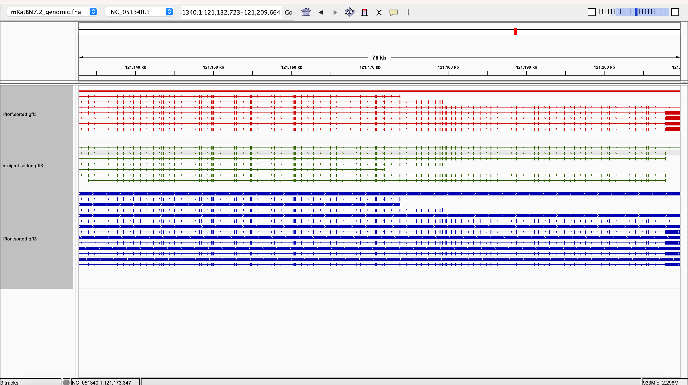
rna-XM_006503178.4 0.3785714285714285 0.987166831194472 0.9375505955822828 0.9886475814412636 LiftOn_chaining_algorithm frameshift NC_051340.1:121132068-121210320

Slide 10
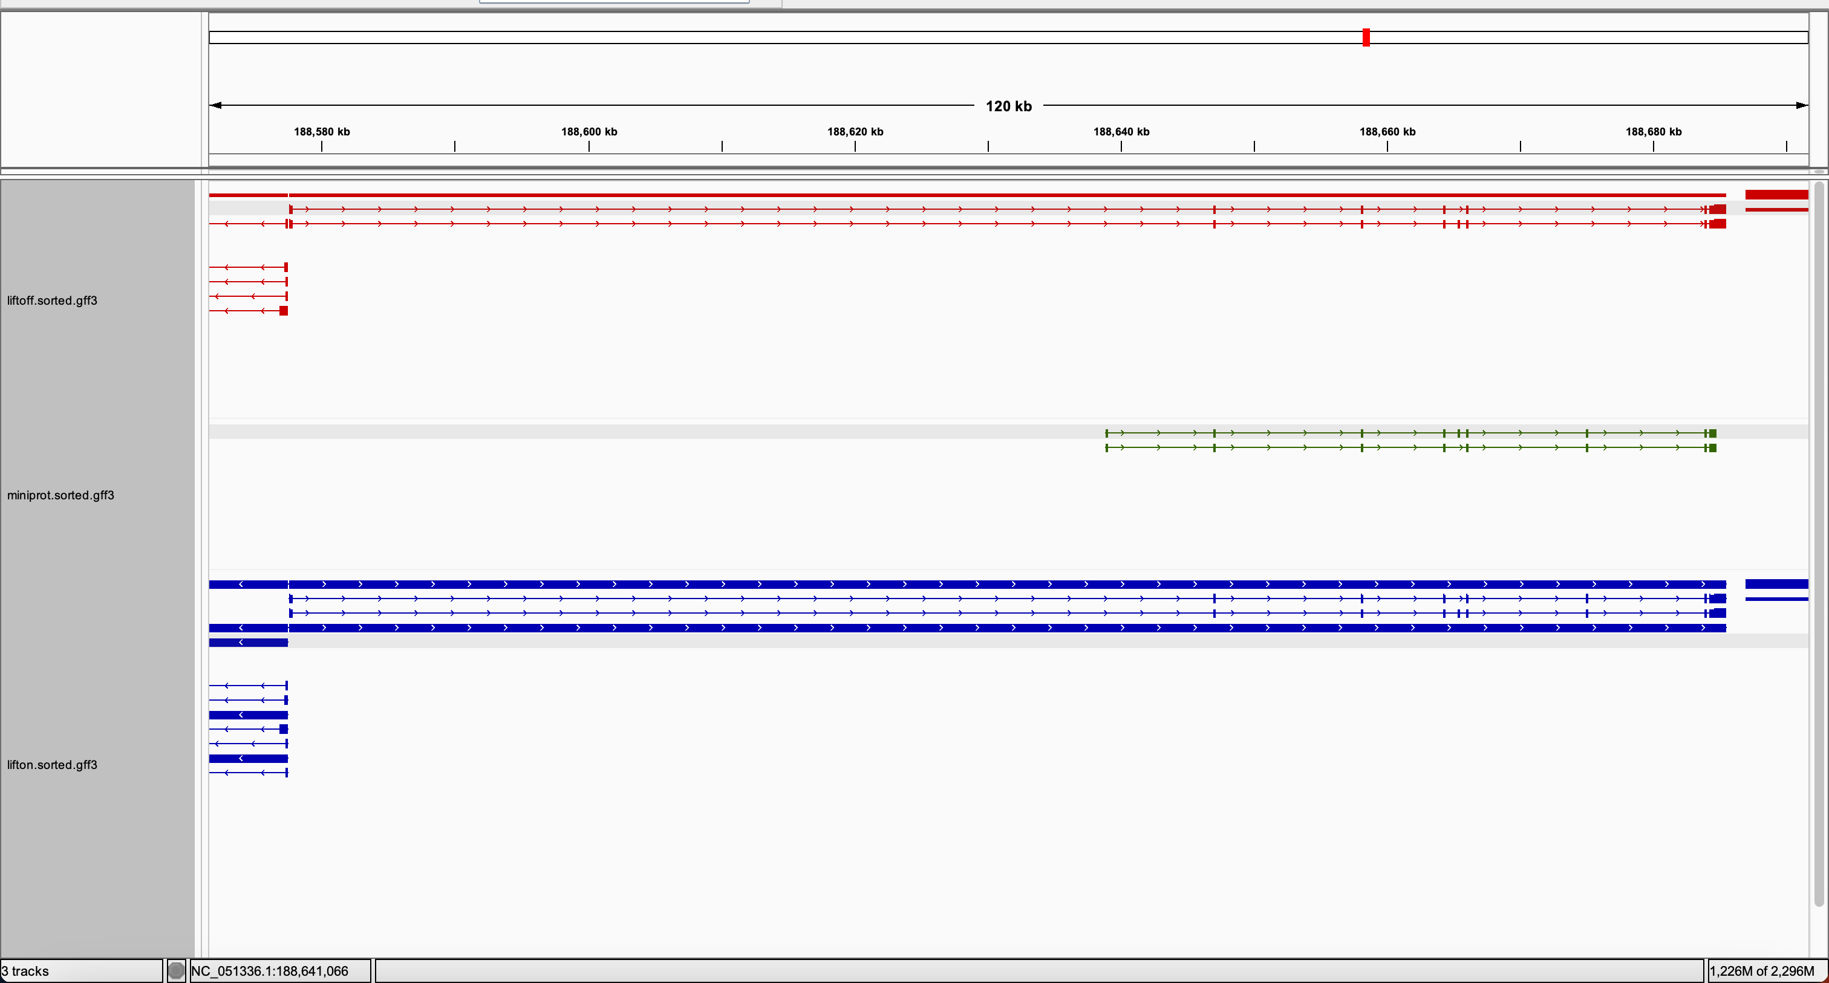
rna-NM_001418758.1 0.446875 0.0125 0.9063786008230452 0.946875 LiftOn_chaining_algorithm frameshift NC_051336.1:188577553-188685500

Slide 11
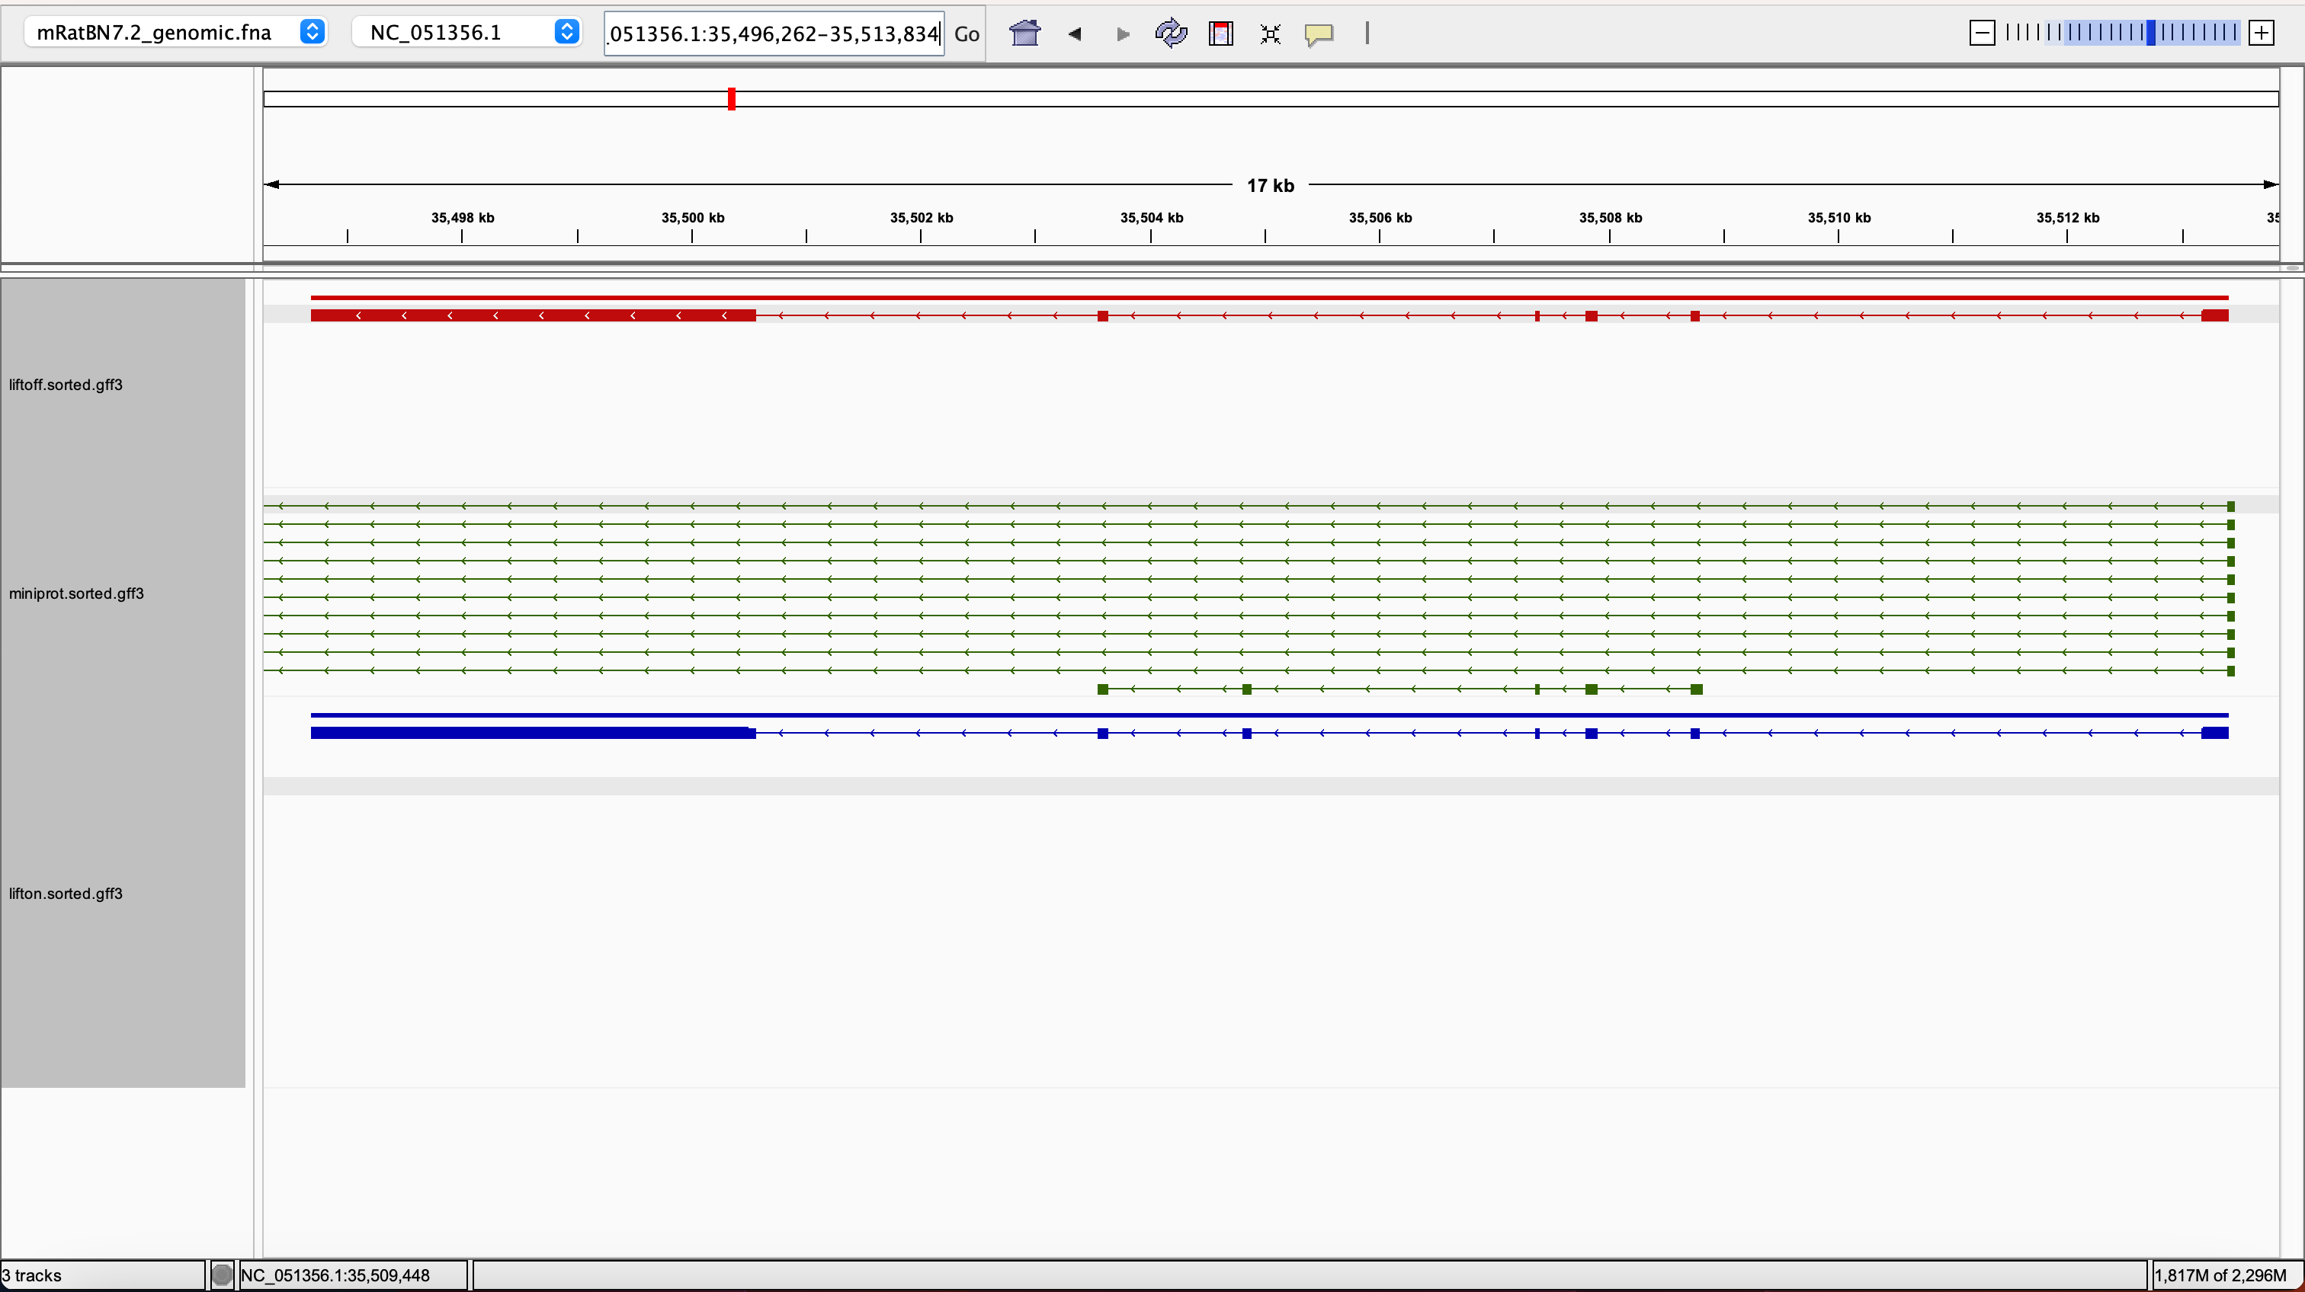
rna-NM_025437.5 0.6206896551724138 0.9586206896551724 0.7264332435552135 1.0 LiftOn_chaining_algorithm frameshift;stop_missing NC_051356.1:35496686-35513410

Slide 12
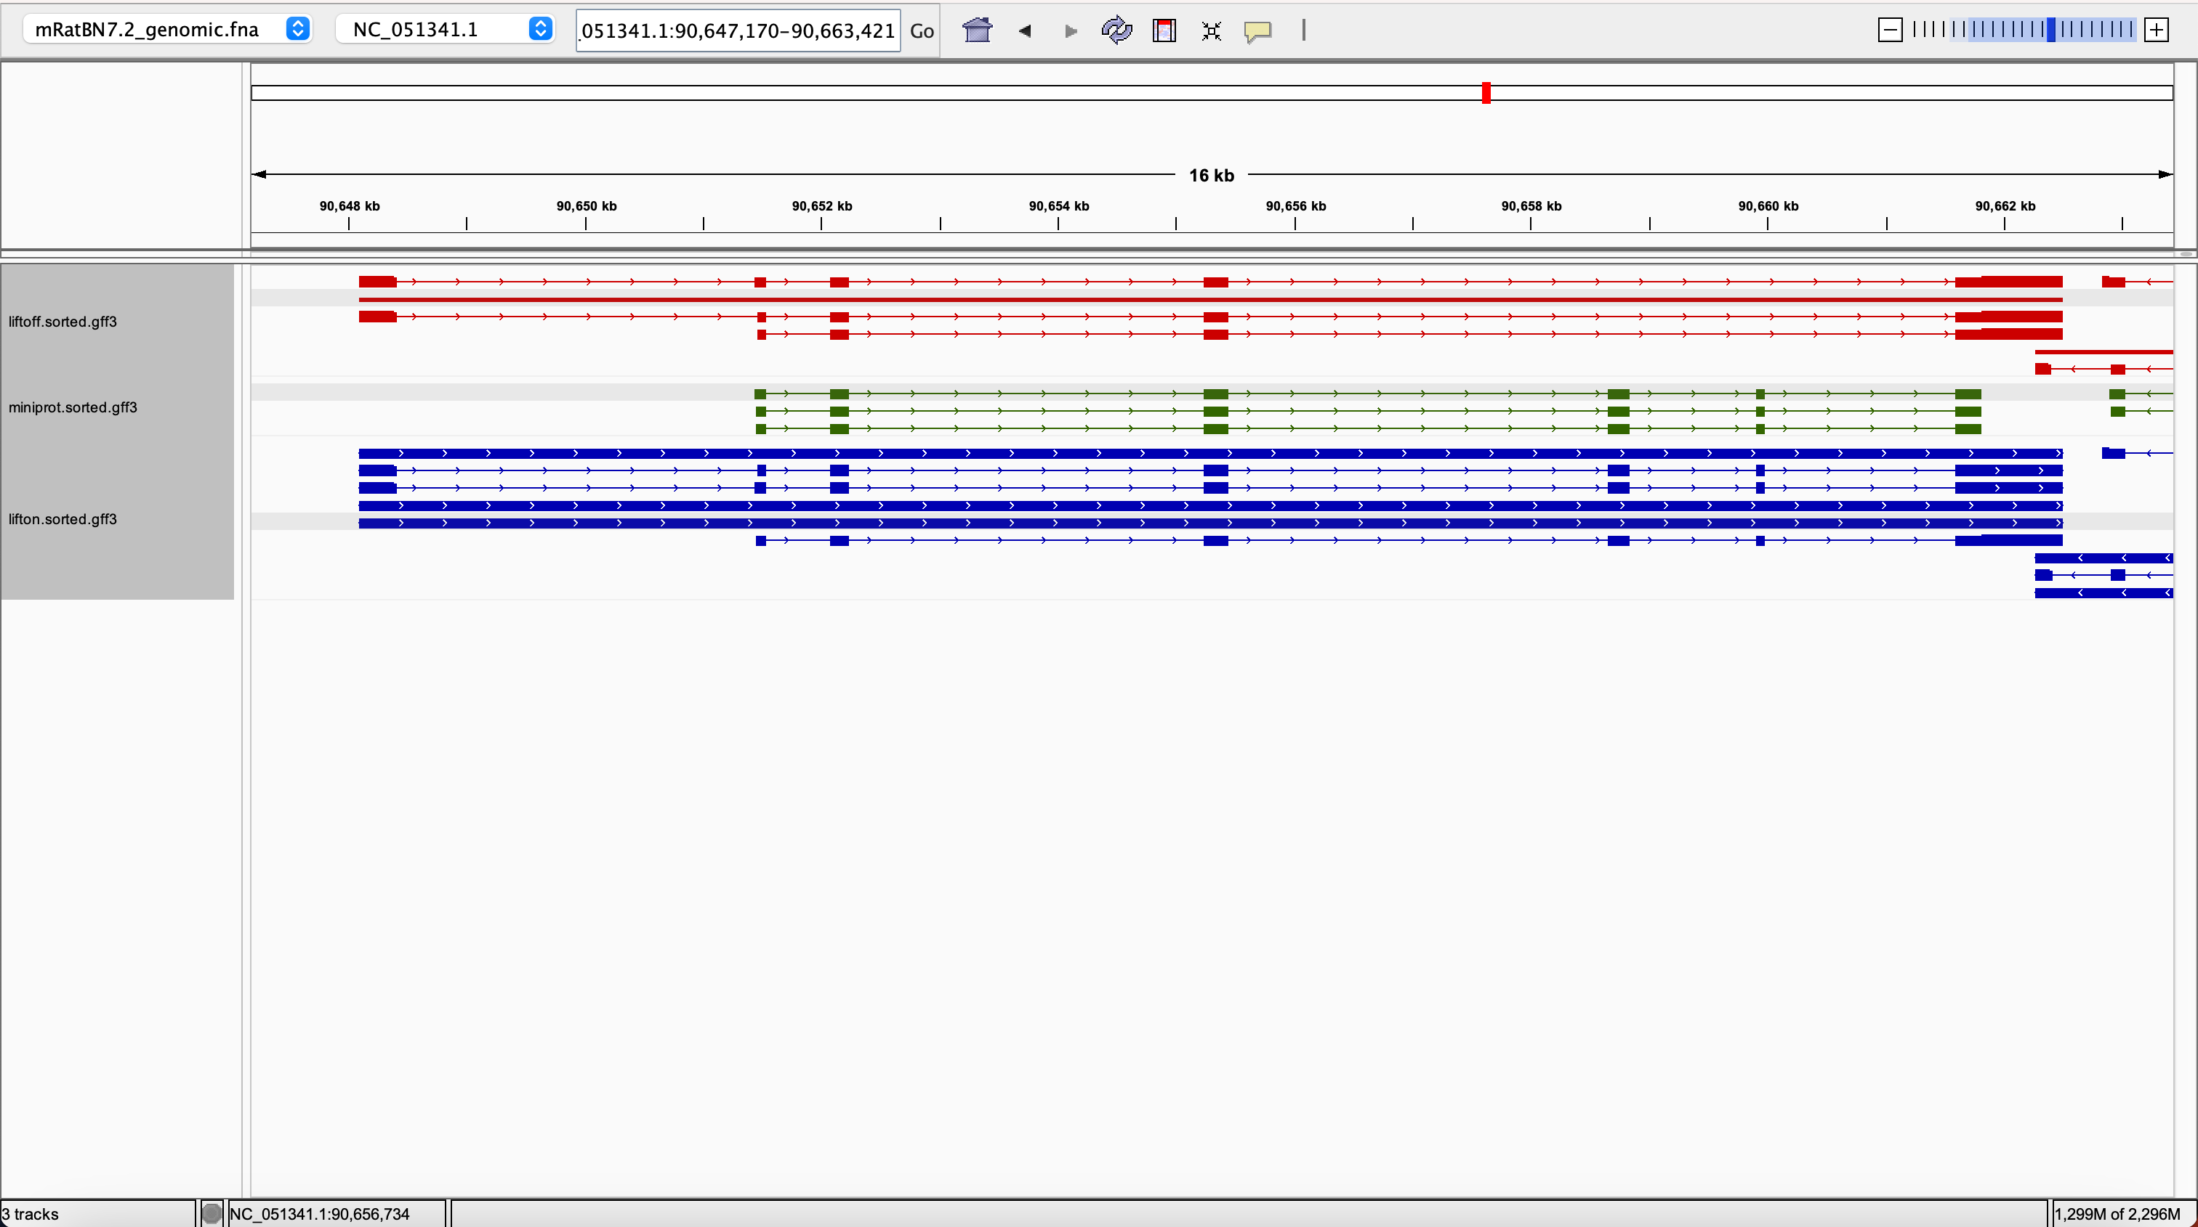
rna-NM_001205067.1 0.5228758169934641 0.9967320261437908 0.866464339908953 1.0 LiftOn_chaining_algorithm synonymous NC_051341.1:90648091-90662501

Slide 13
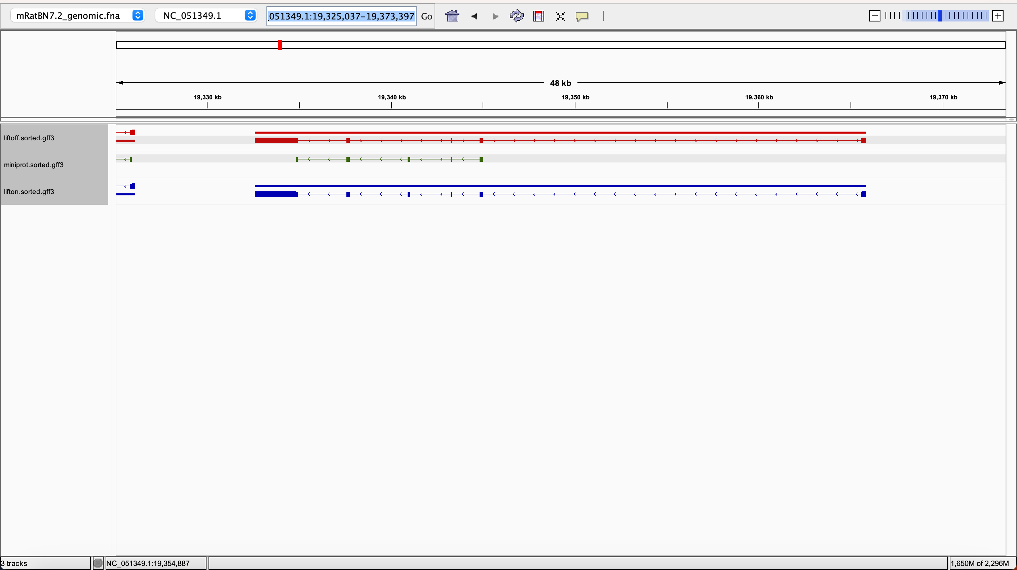
rna-NM_026735.2 0.4654377880184331 0.976958525345622 0.8966376089663761 1.0 LiftOn_chaining_algorithm synonymous NC_051349.1:19332602-19365831

Slide 14
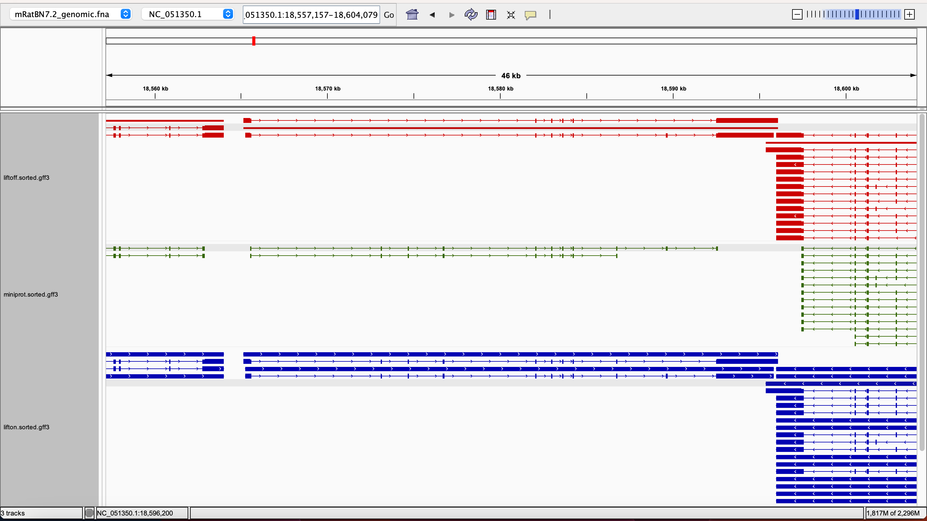
rna-XM_036158766.1 0.127906976744186 0.9883040935672516 0.877502691065662 1.0 LiftOn_chaining_algorithm frameshift;stop_missing NC_051350.1:18565150-18596086

Slide 15
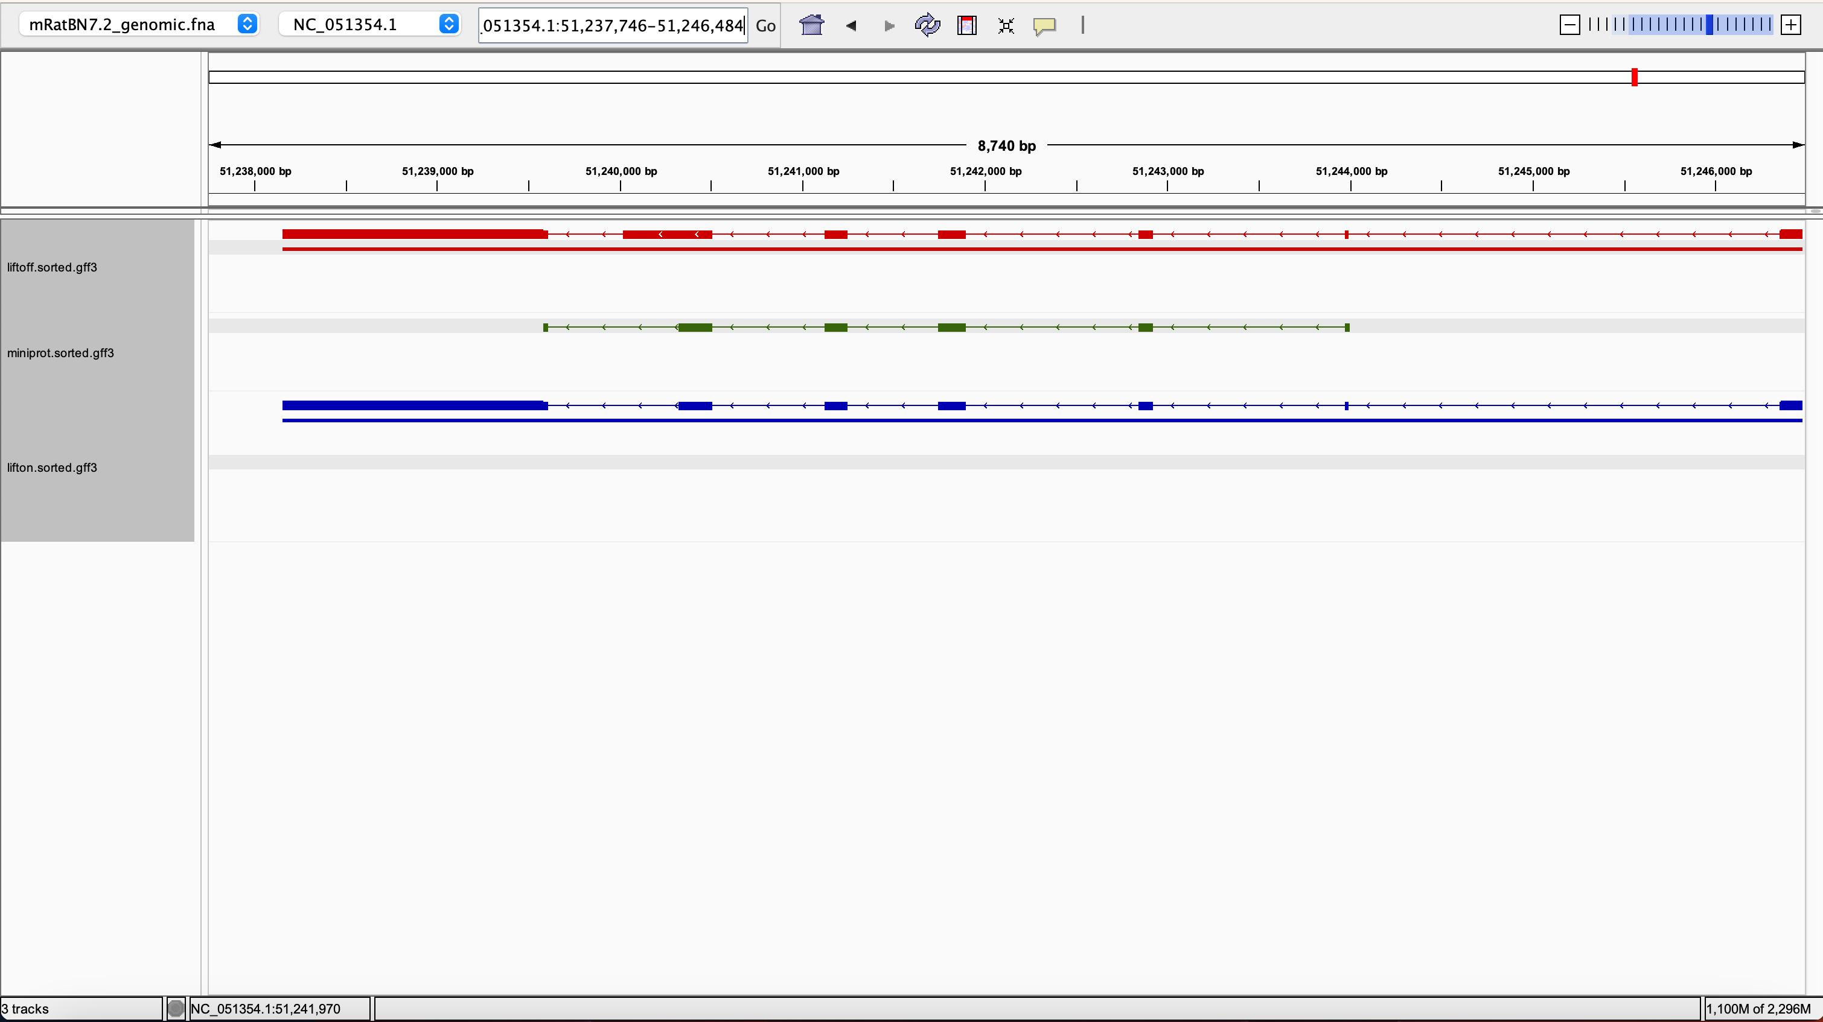
rna-NM_145606.3 0.6397306397306397 0.9898477157360406 0.8523035230352304 1.0 LiftOn_chaining_algorithm synonymous NC_051354.1:51238154-51246477

Slide 16
lifton = liftoff only

Slide 17
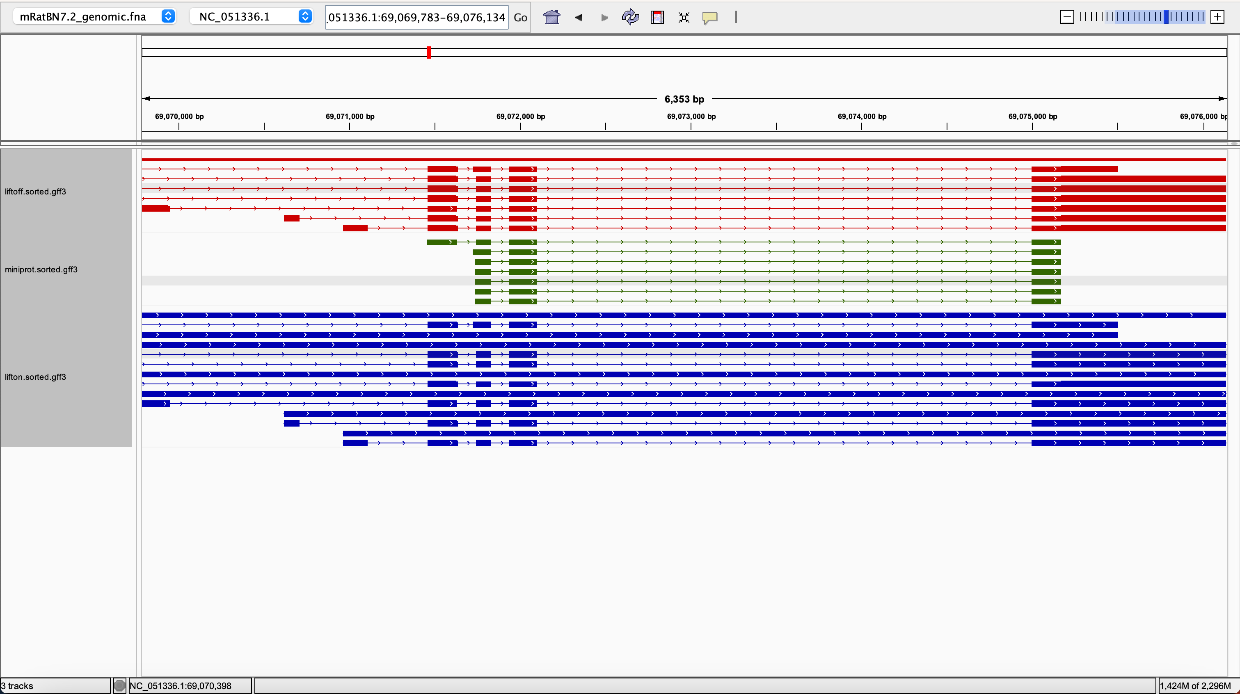
rna-NM_008350.5 0.97 0.955 0.7884906612821807 0.97 LiftOn_chaining_algorithm frameshift NC_051336.1:69069783-69076134

Slide 18
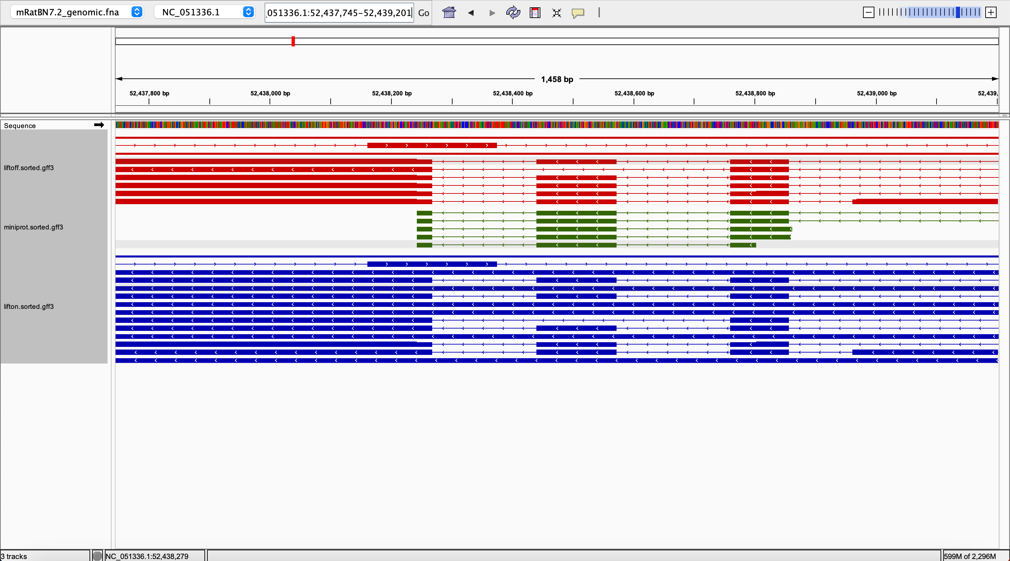
rna-XM_011246219.4 0.9885057471264368 0.9770114942528736 0.9207920792079208 0.9885057471264368 LiftOn_chaining_algorithm frameshift;start_lost NC_051336.1:52437745-52439201

Slide 19
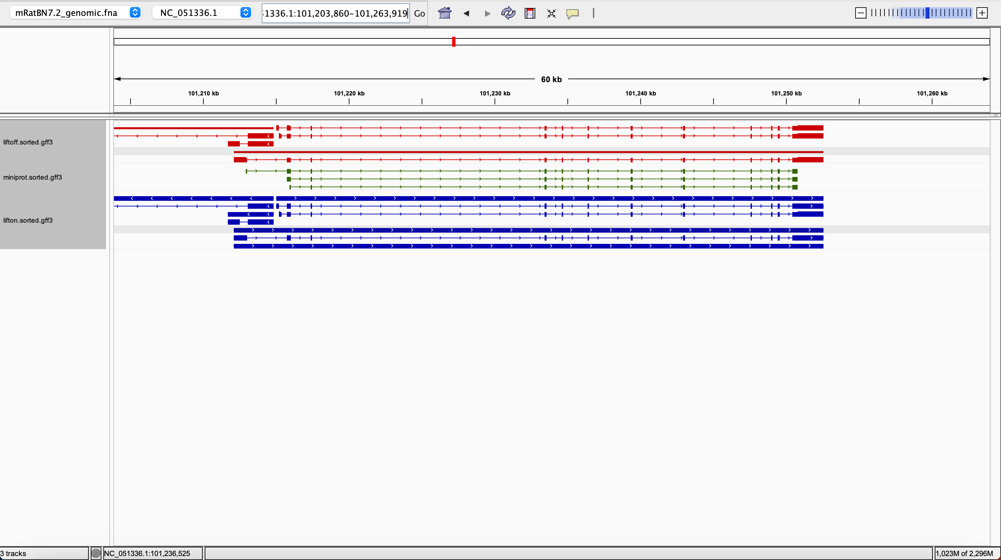
rna-XM_006540601.5 0.9946043165467626 0.9928057553956836 0.932352108689499 0.9946043165467626 LiftOn_chaining_algorithm frameshift;start_lost NC_051336.1:101215224-101252556

Slide 20
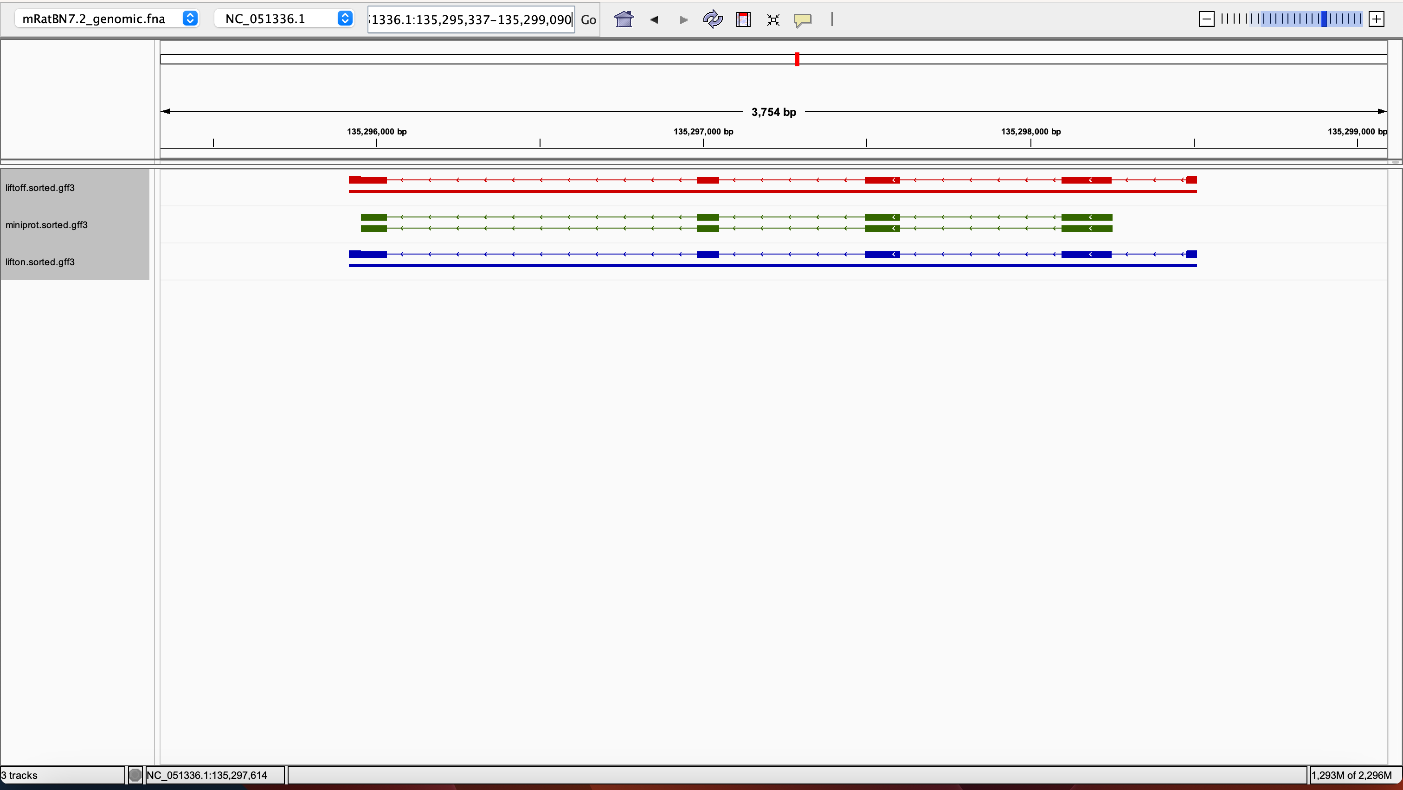
rna-NM_009092.3 0.9926470588235294 0.9852941176470588 0.9514767932489452 0.9926470588235294 LiftOn_chaining_algorithm nonsynonymous N

Slide 21
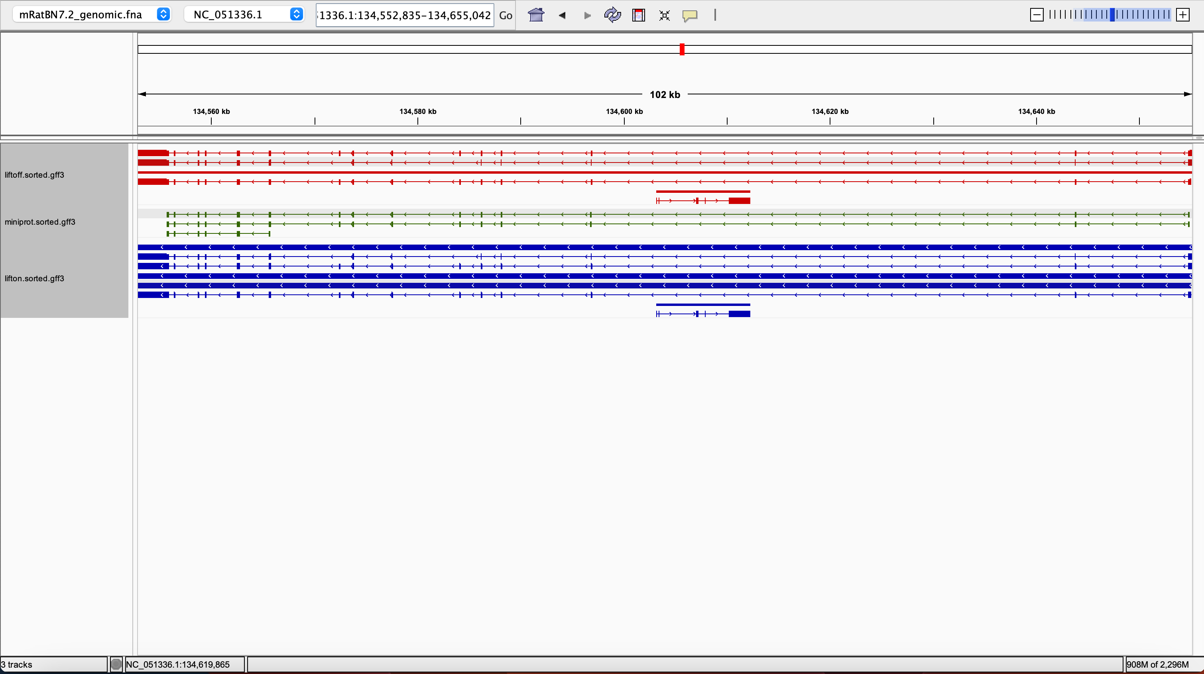
rna-NM_173863.2 0.9532258064516128 0.1797752808988764 0.7941065357007934 0.9532258064516128 LiftOn_chaining_algorithm frameshift NC_051336.1:134552835-134655042

Slide 22
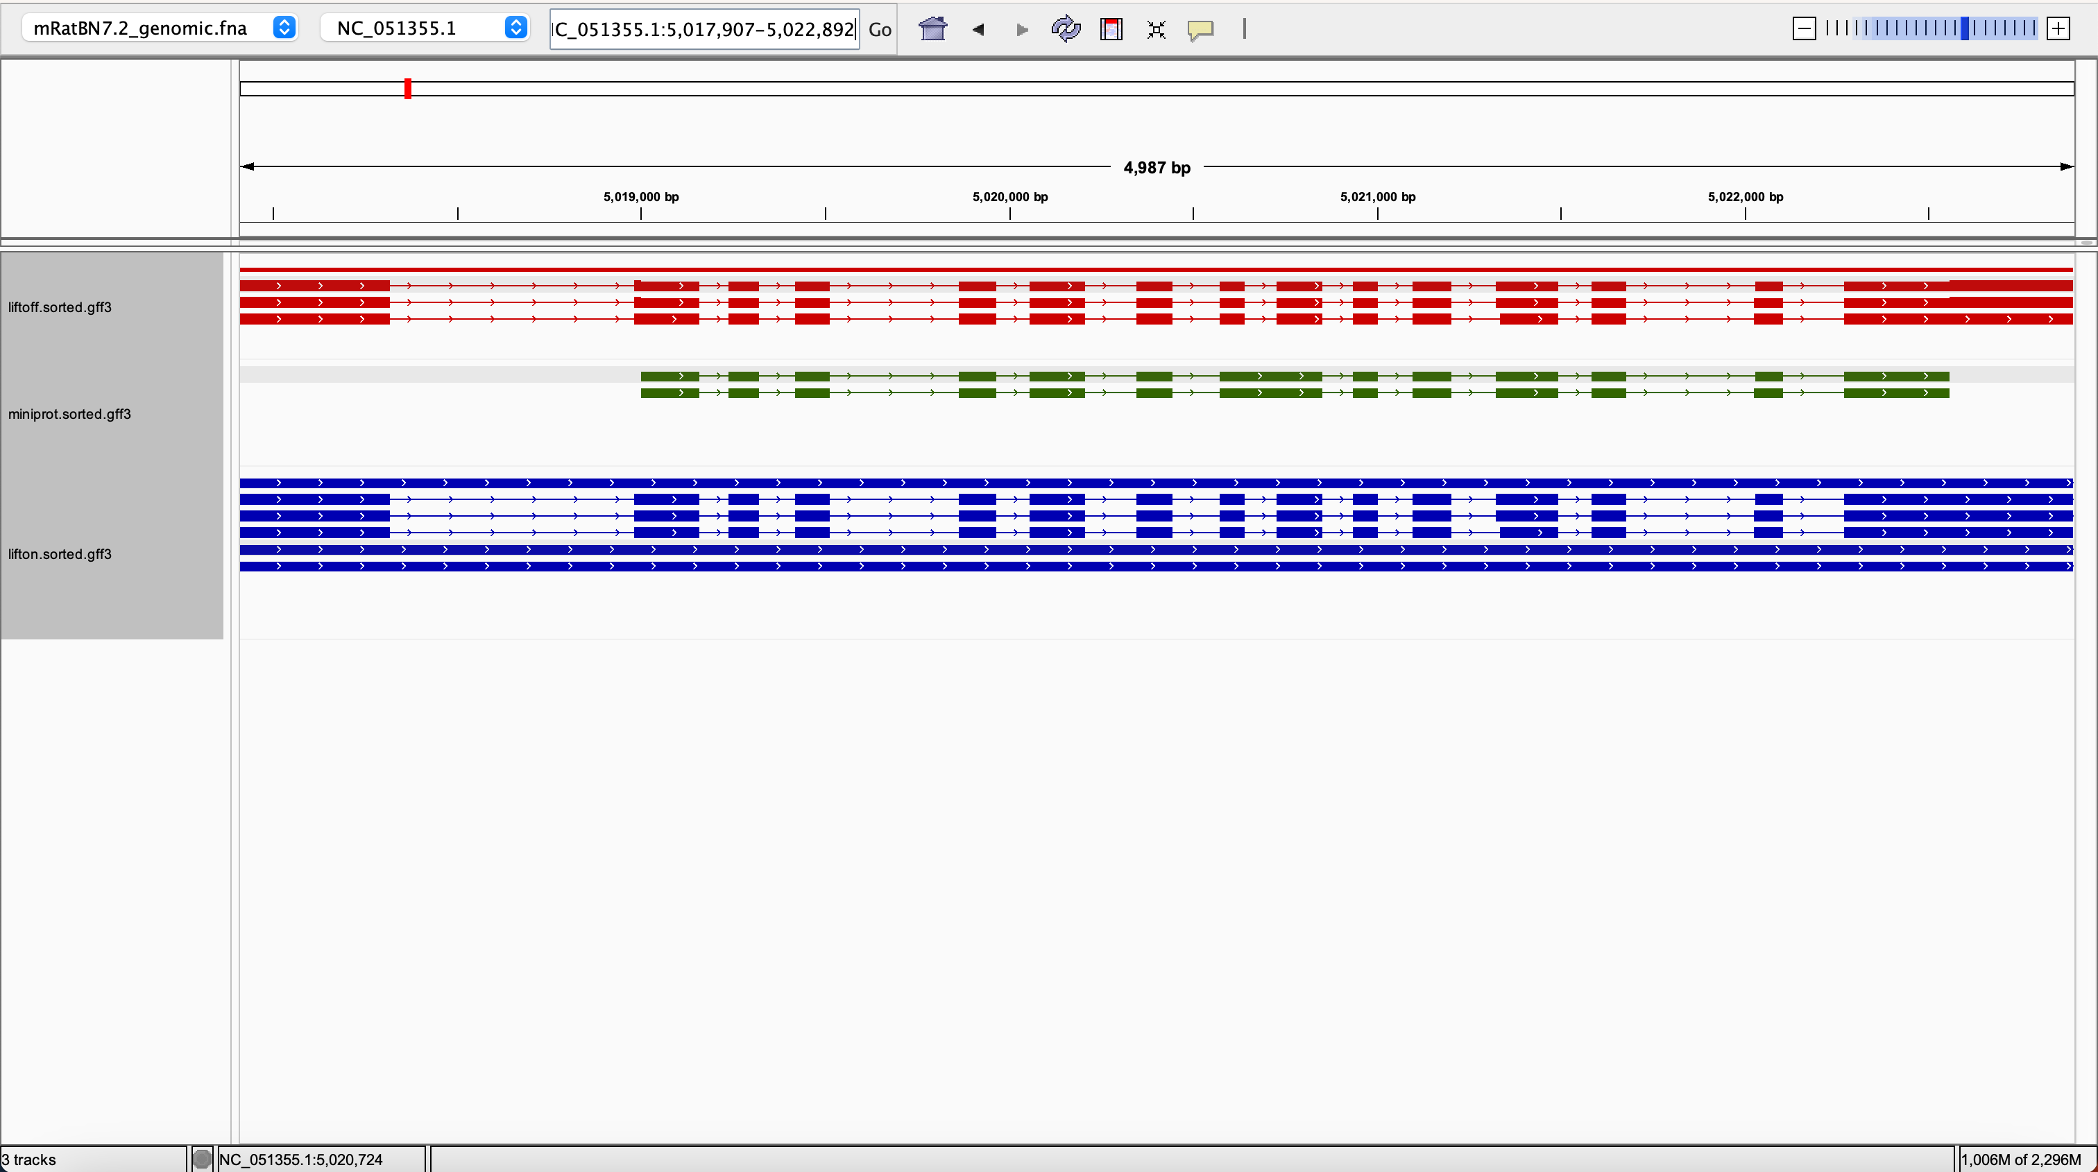
rna-NM_009343.3 0.9803571428571428 0.4244482173174873 0.9329813160032494 0.9803571428571428 LiftOn_chaining_algorithm frameshift NC_051355.1:5017907-5022892

Slide 23
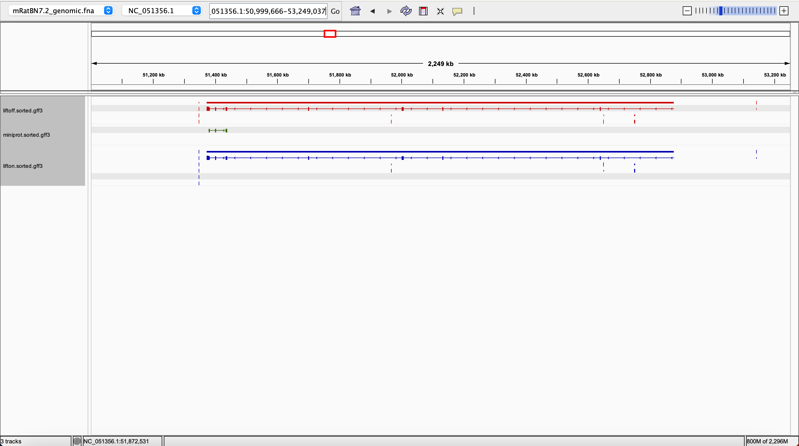
rna-NM_001160403.2 0.9928263988522238 0.6255380200860832 0.9332696796095904 0.9928263988522238 LiftOn_chaining_algorithm frameshift NC_051356.1:51372035-52876667

Slide 24
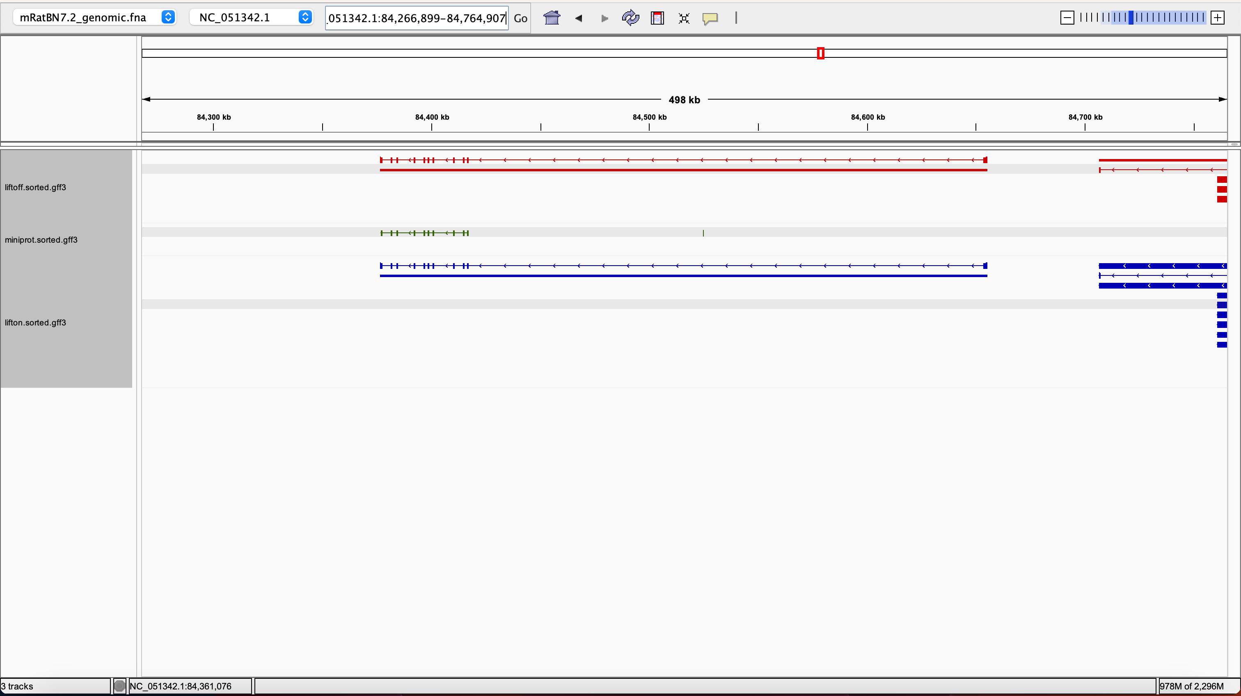
rna-NM_010162.2 1.0 0.570281124497992 0.9789746543778802 1.0 Liftoff_synonymous synonymous NC_051342.1:84376482-84655325

Slide 25
lifton = miniprot only

Slide 26
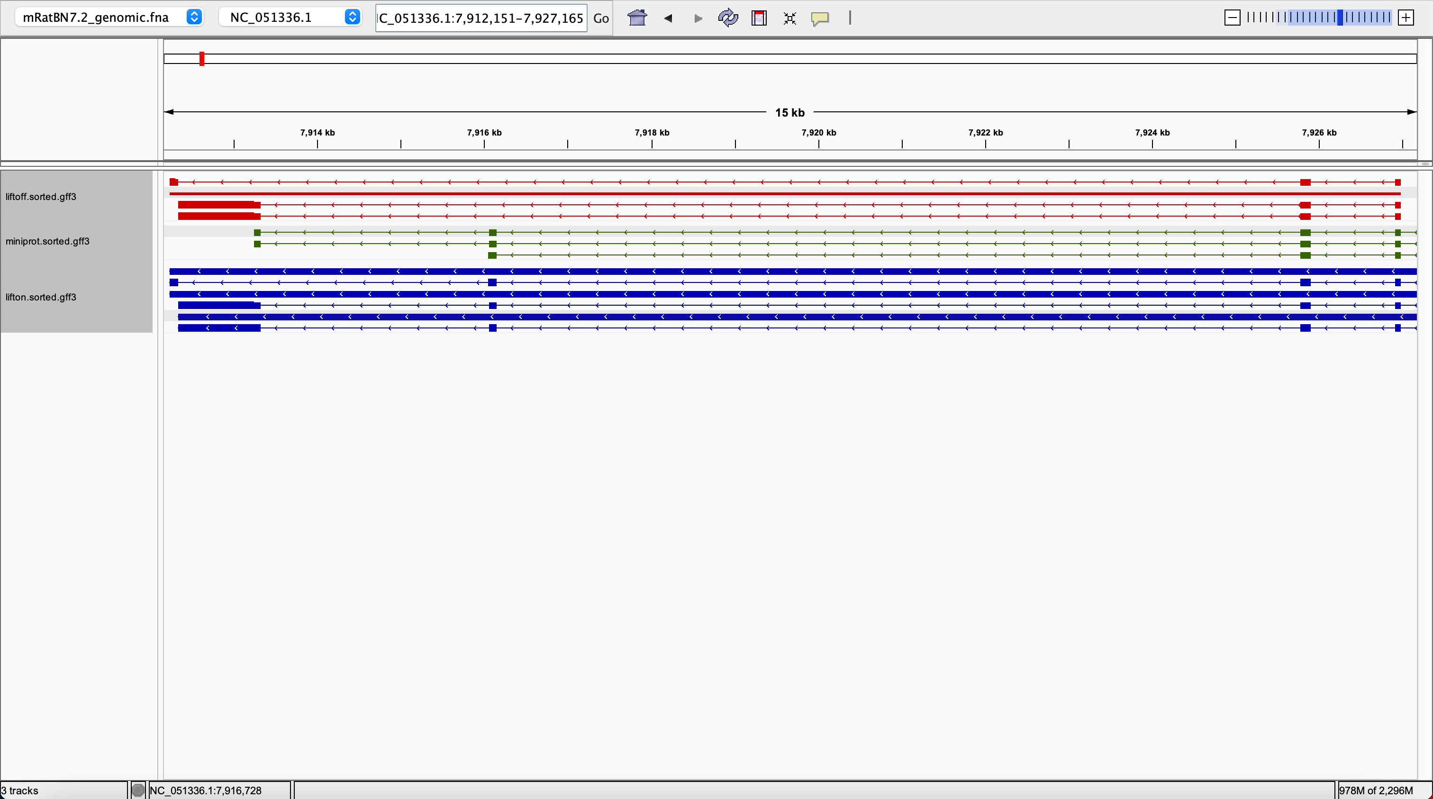
rna-NM_001347361.1 0.2052117263843648 0.9609120521172638 0.7473875511131304 0.9609120521172638 LiftOn_chaining_algorithm frameshift;start_lost NC_051336.1:7912334-7926982

Slide 27
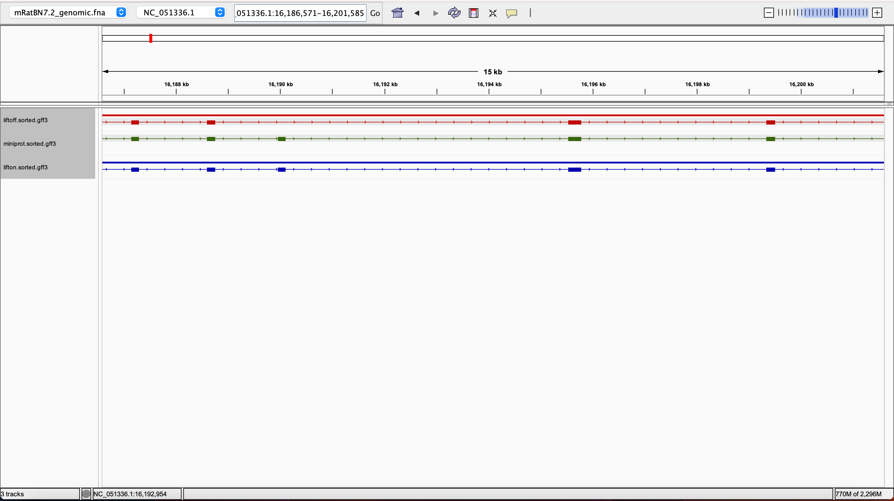
rna-NM_178713.4 0.8524590163934426 0.9528688524590164 0.7659492697924674 0.9528688524590164 LiftOn_chaining_algorithm frameshift NC_051336.1:16183933-16204223

Slide 28
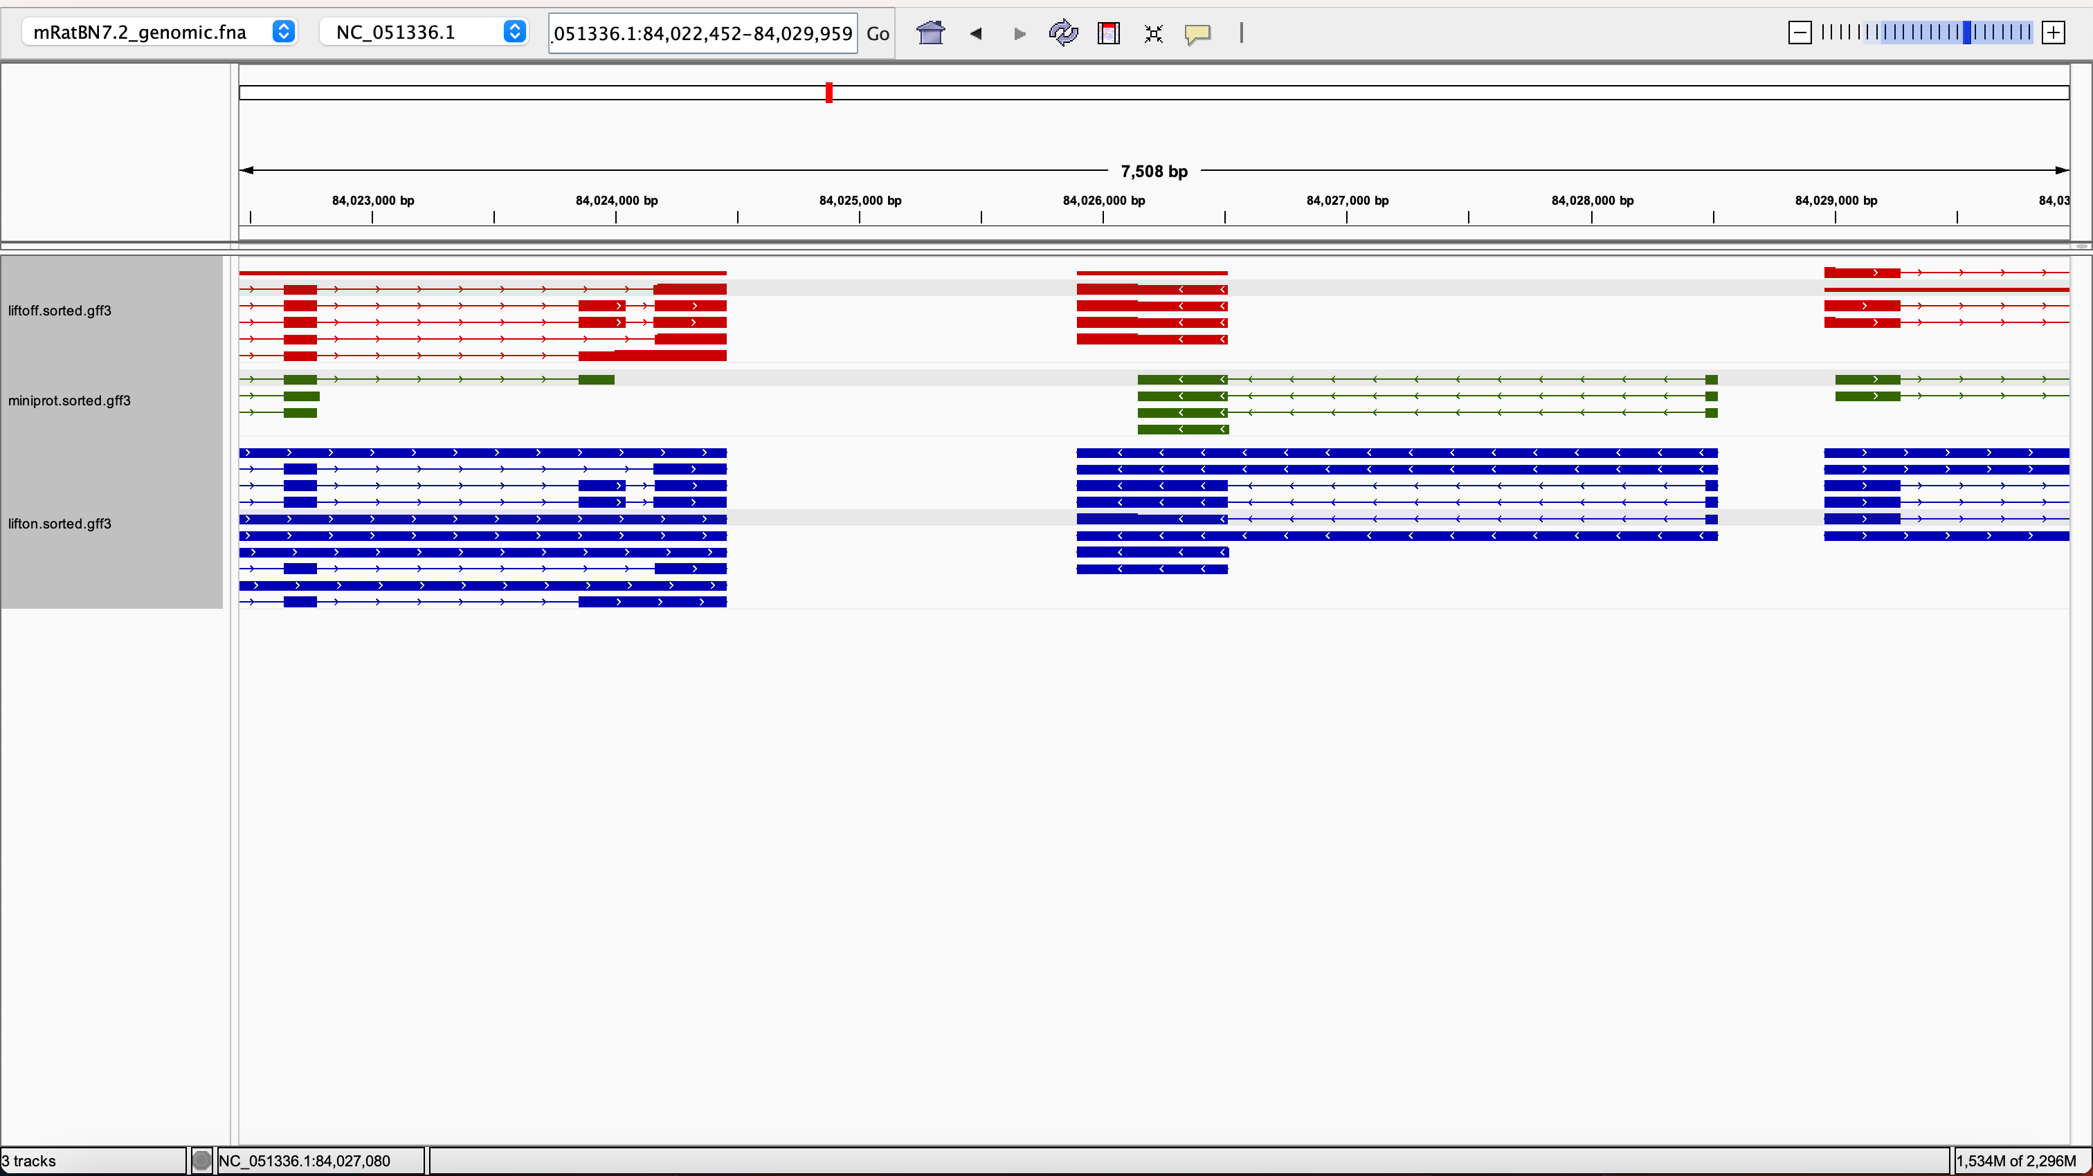
rna-NM_011885.5 0.0 0.9714285714285714 0.8072289156626506 0.9714285714285714 LiftOn_chaining_algorithm frameshift NC_051336.1:84025896-84026514

Slide 29
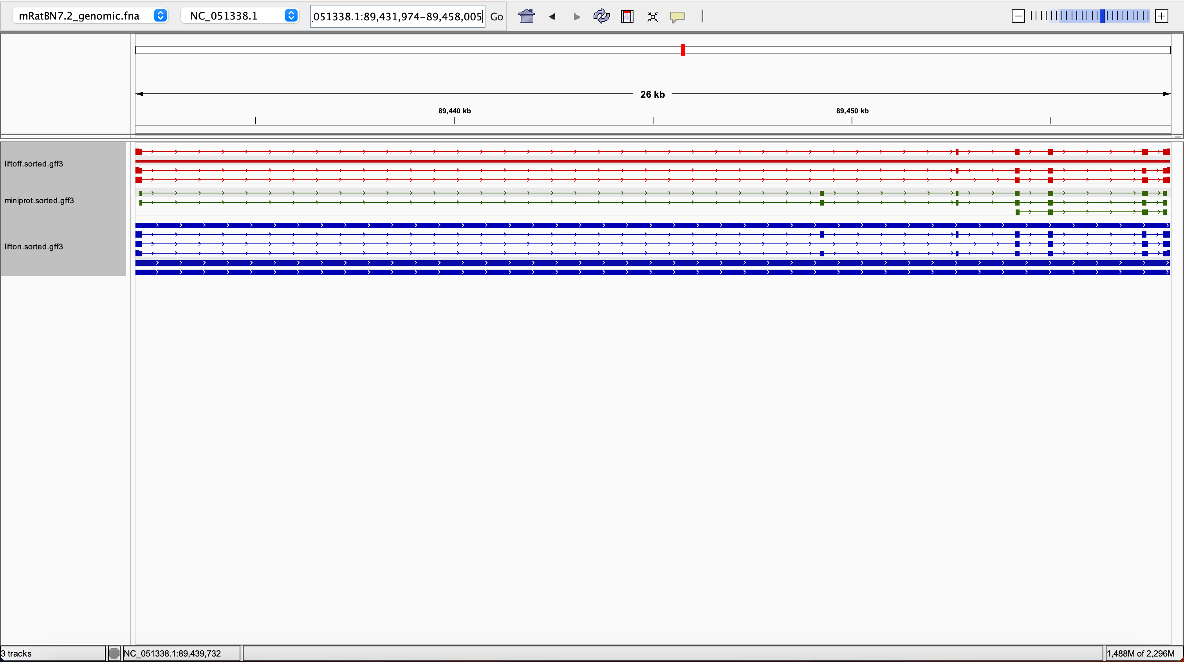
rna-NM_001355473.1 0.068825910931174 0.9737991266375546 0.9209932279909706 0.9737991266375546 LiftOn_chaining_algorithm frameshift NC_051338.1:89431974-89458005

Slide 30
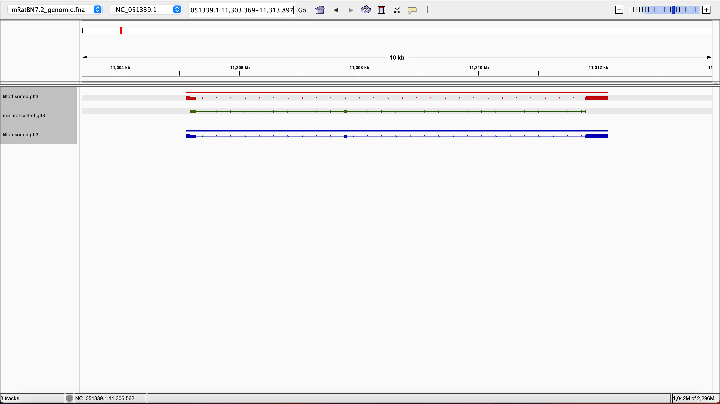
rna-NM_025394.3 0.625 1.0 0.477047704770477 1.0 LiftOn_chaining_algorithm synonymous NC_051339.1:11305102-11312164

Slide 31
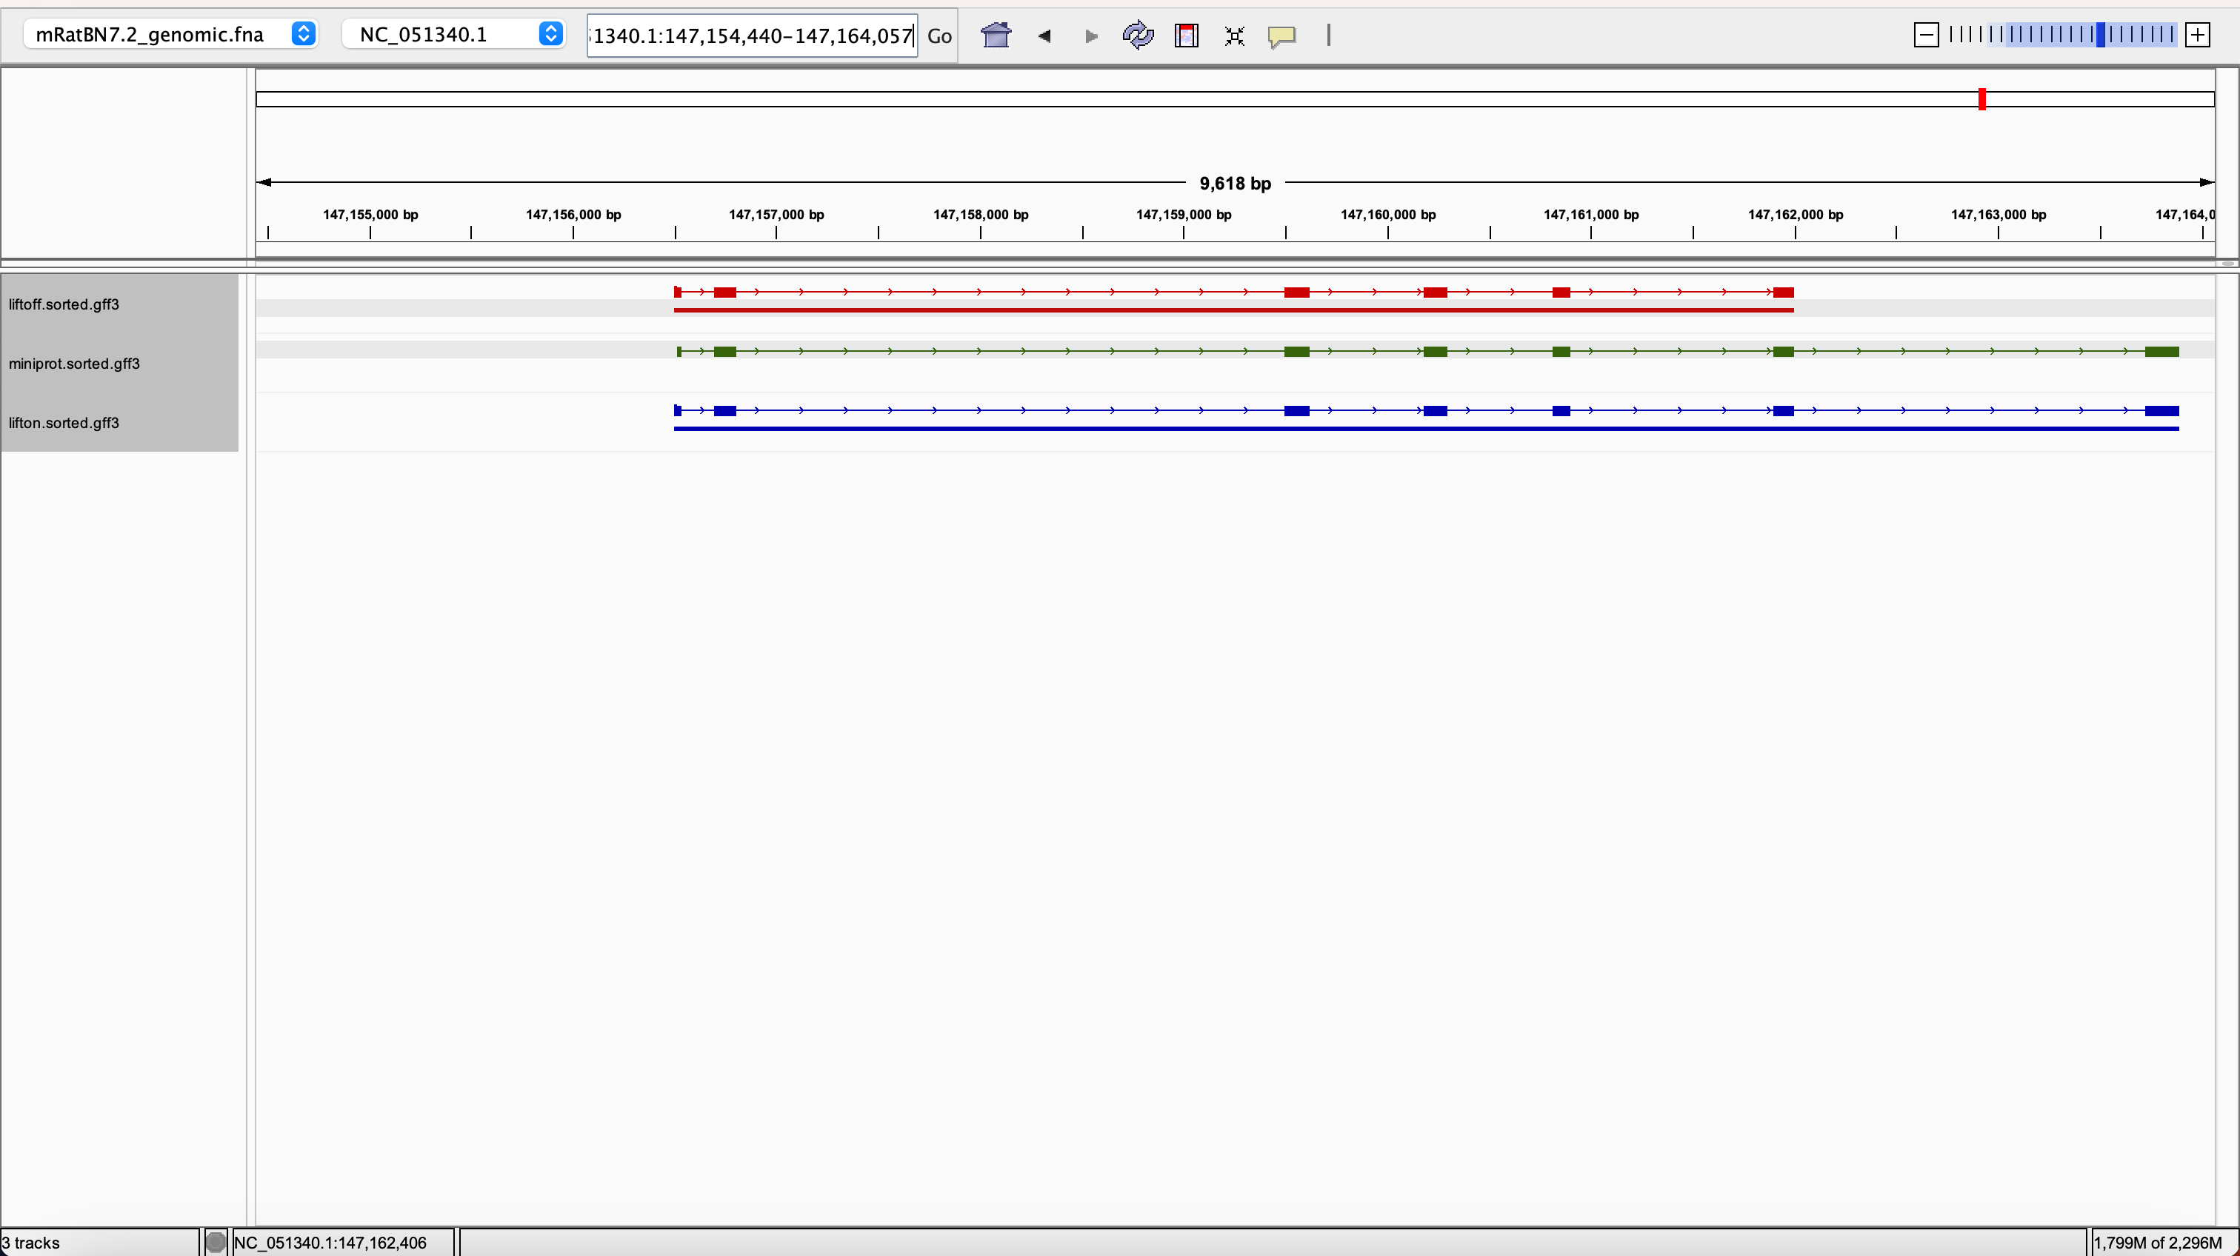
rna-NM_026780.3 0.7695473251028807 1.0 0.5555555555555556 1.0 LiftOn_chaining_algorithm synonymous NC_051340.1:147156499-147161997

Slide 32
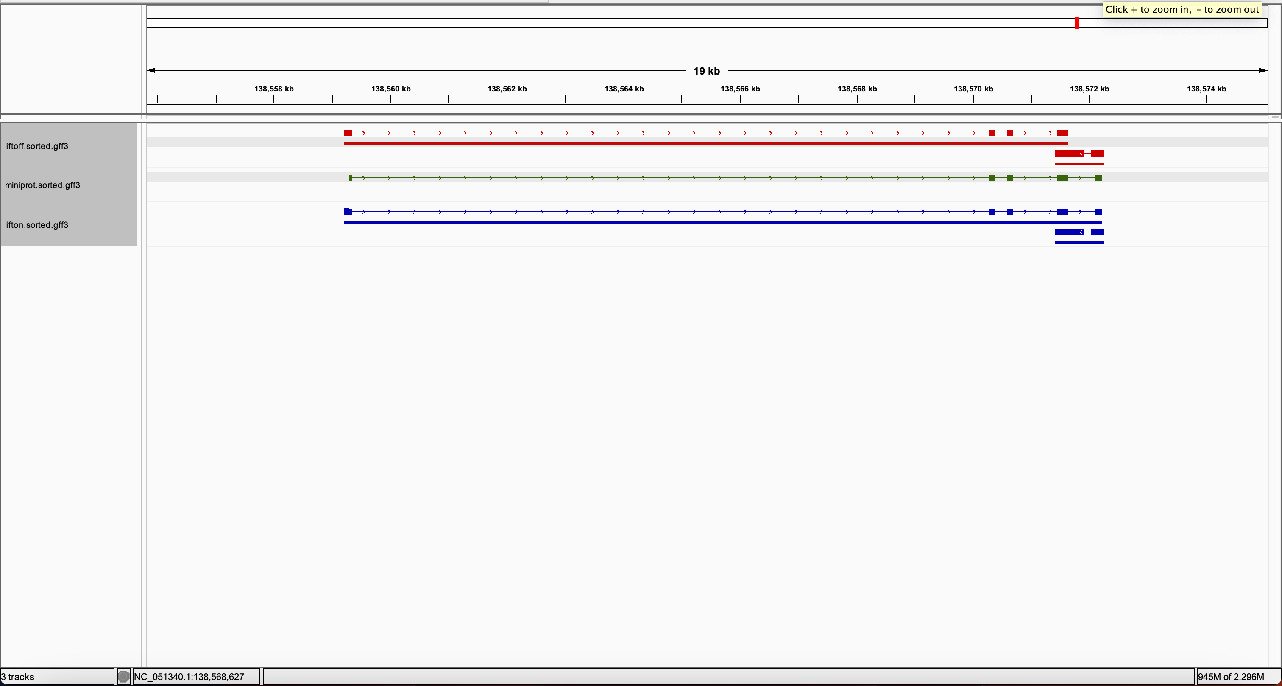
rna-NM_013718.2 0.7790055248618785 1.0 0.4836913285600636 1.0 LiftOn_chaining_algorithm synonymous NC_051340.1:138559215-138571633

Slide 33
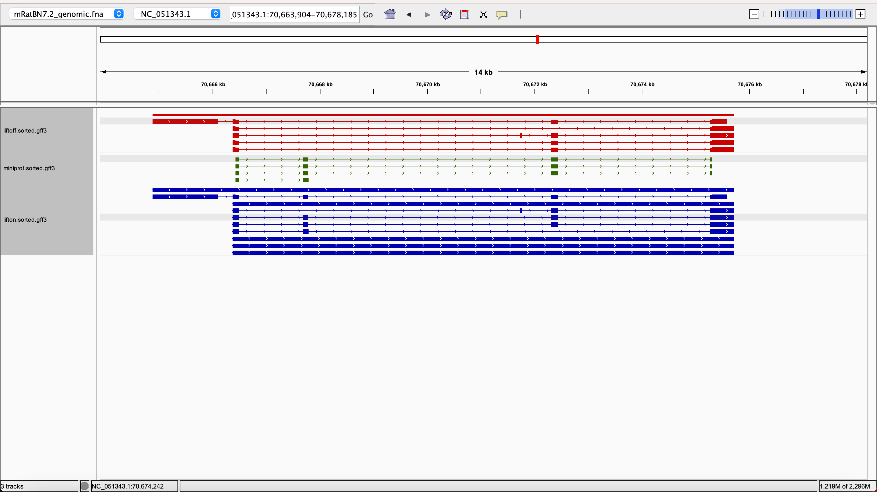
rna-NM_001039519.2 0.6818181818181818 1.0 0.8149779735682819 1.0 LiftOn_chaining_algorithm synonymous NC_051343.1:70666382-70675707

